Slide 1
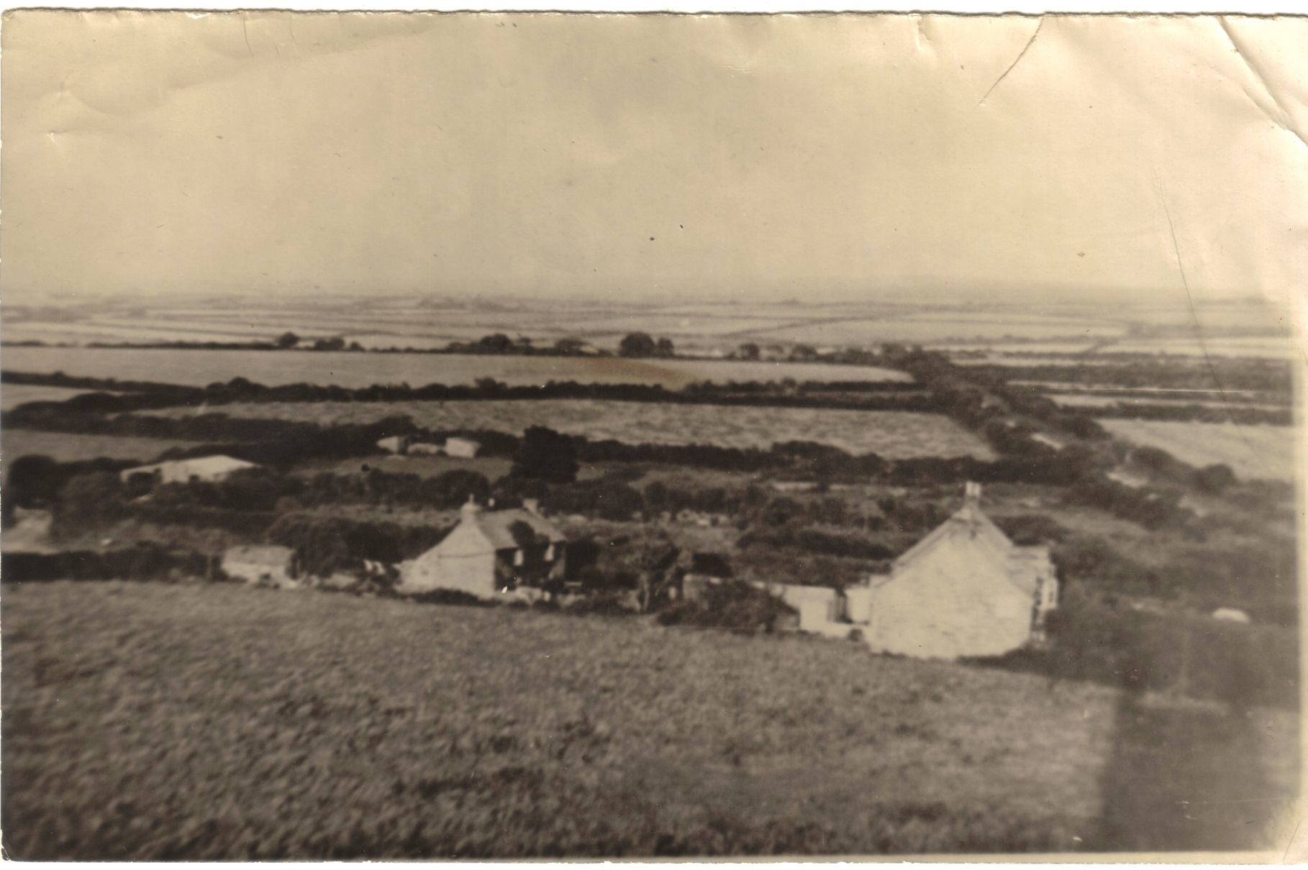
St Eval During the War

Slide 2
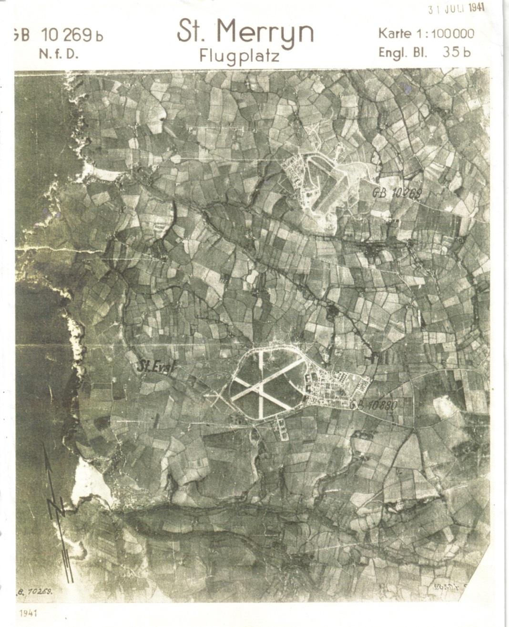
St Eval from German plane July 1941

Slide 3
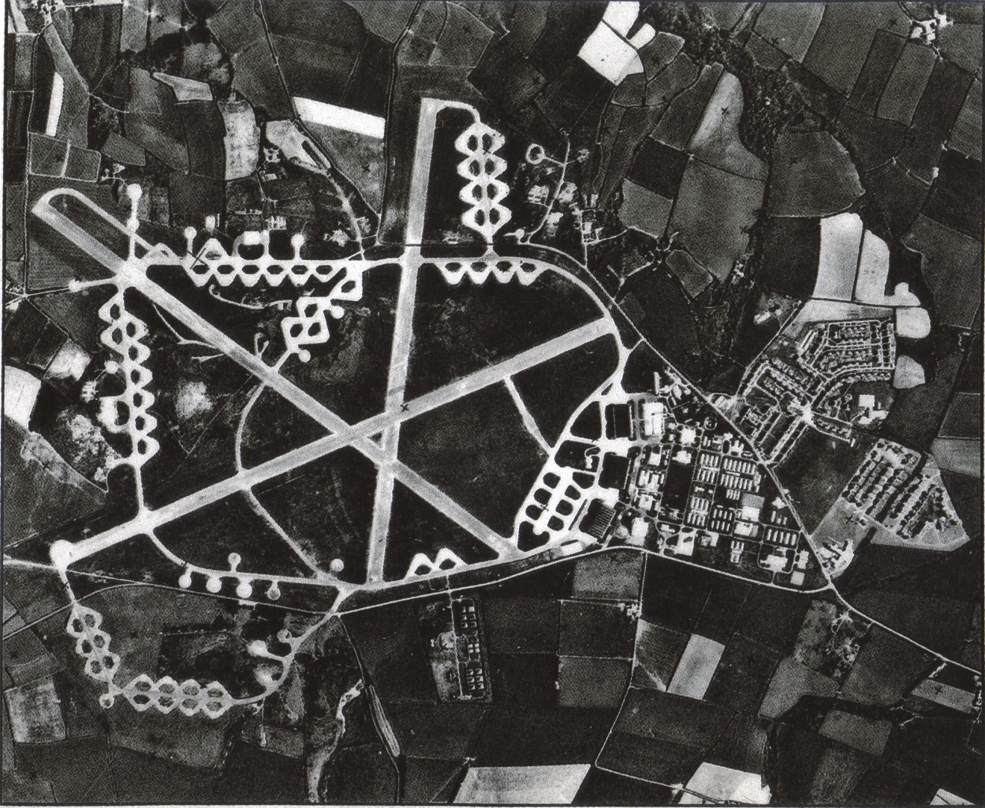
St Eval Airfield 1967 with dispersal bays and taxi ways connecting the thresh holds of runways 02 and 08

Slide 4
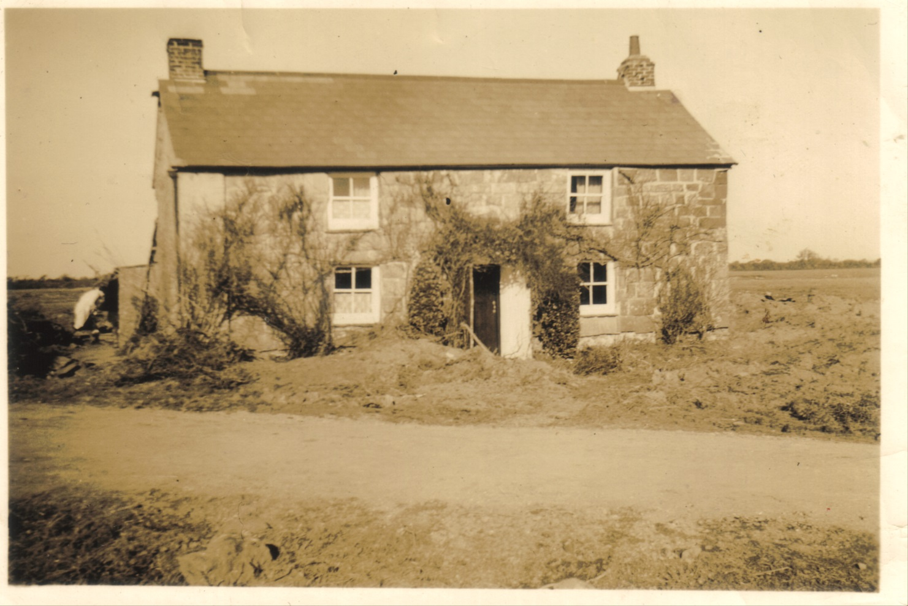
St Eval Village 1938

Slide 5
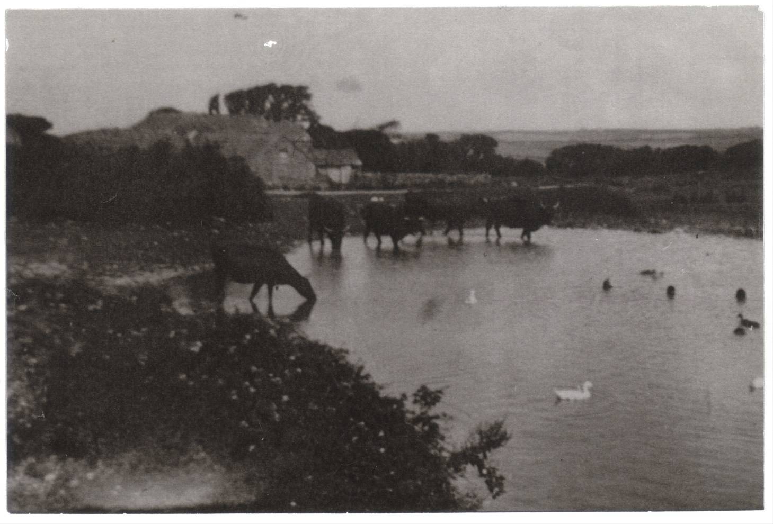
Trevisker St Eval

Slide 6
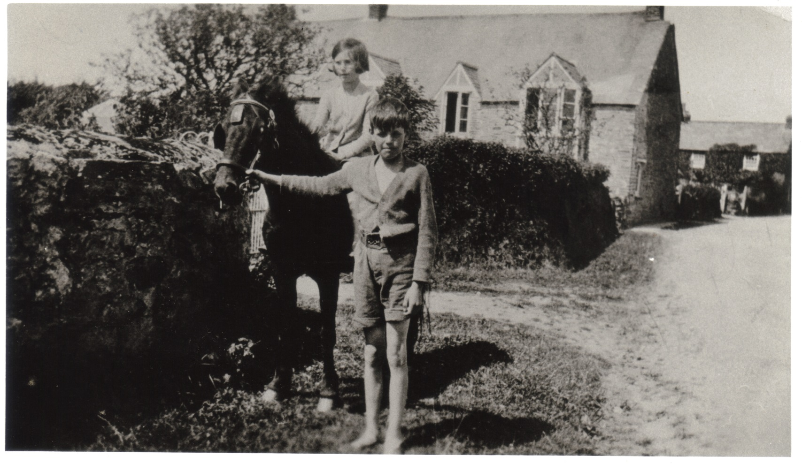
St Eval Church town 1936

Slide 7
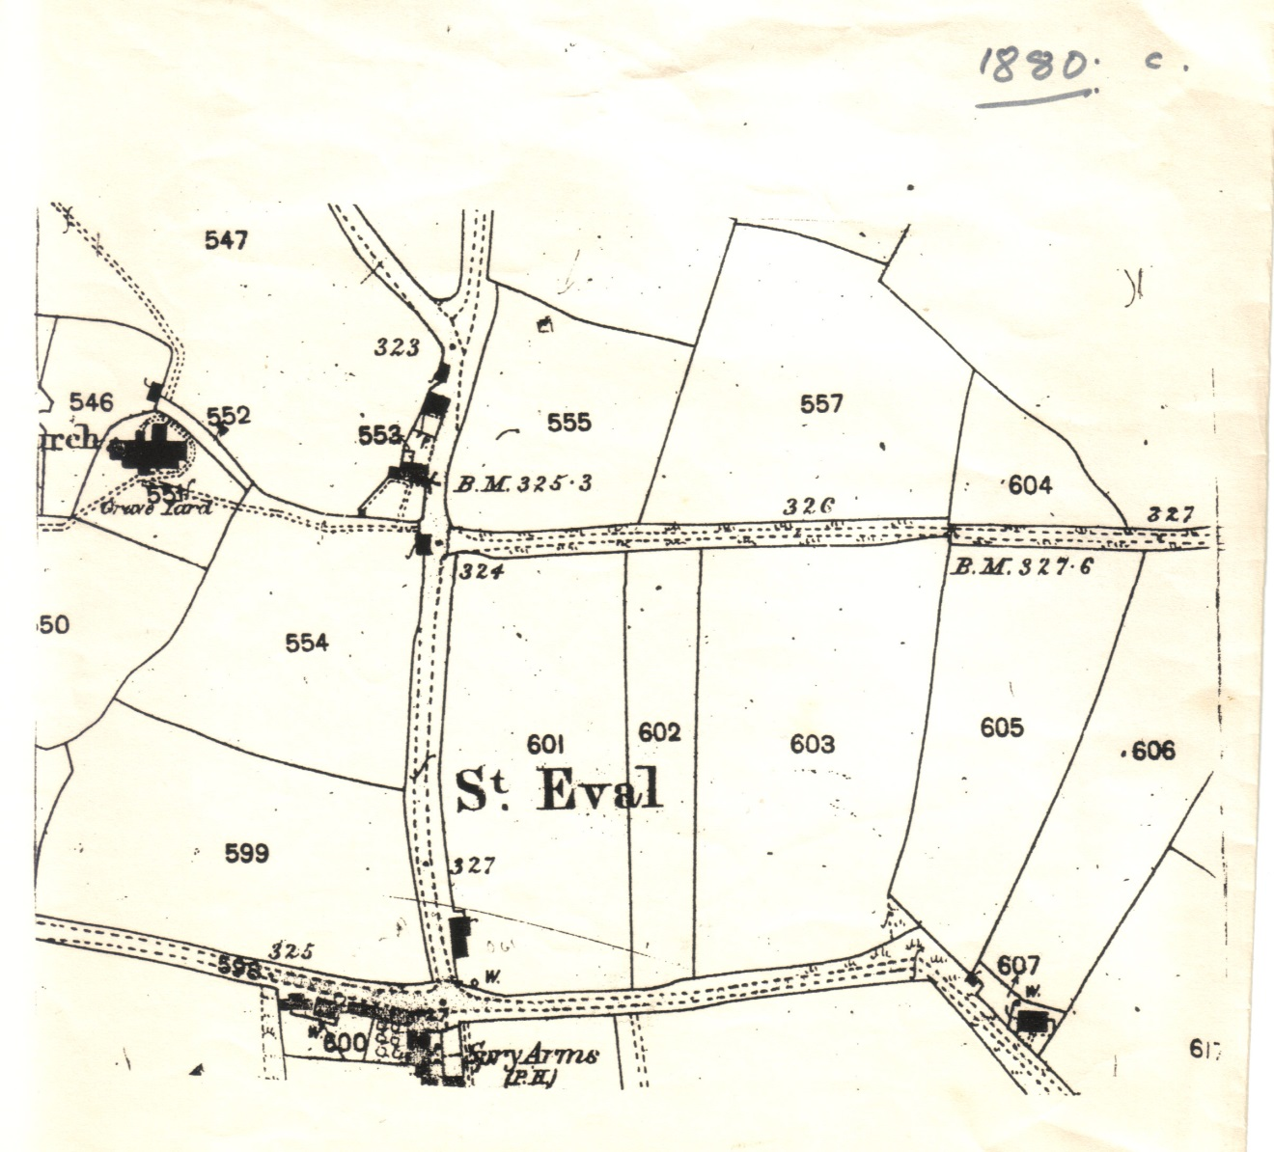
St Eval Church town 1880

Slide 8
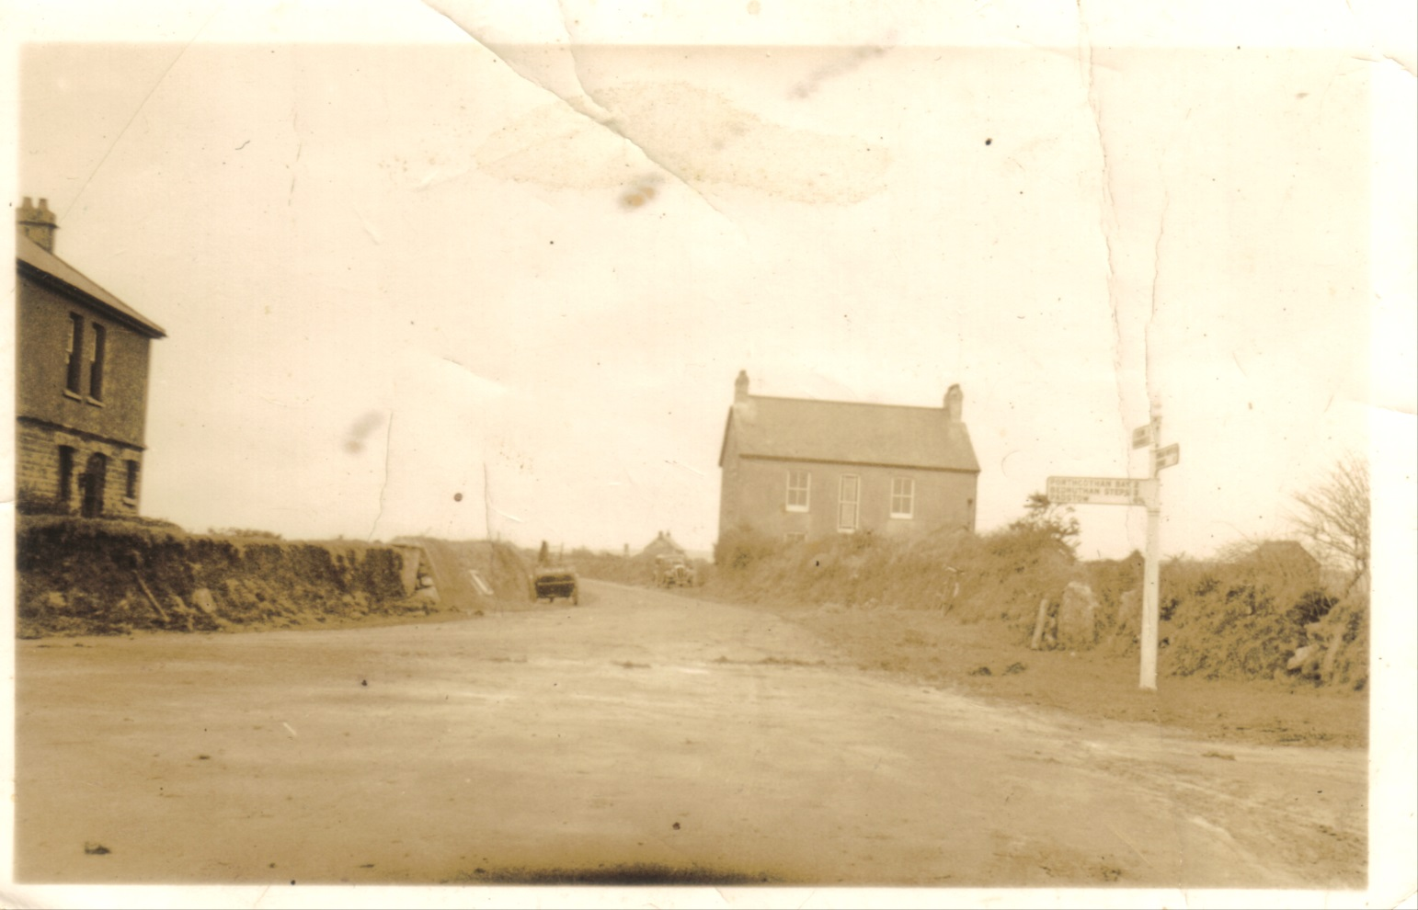
St Eval crossroads 1938

Slide 9
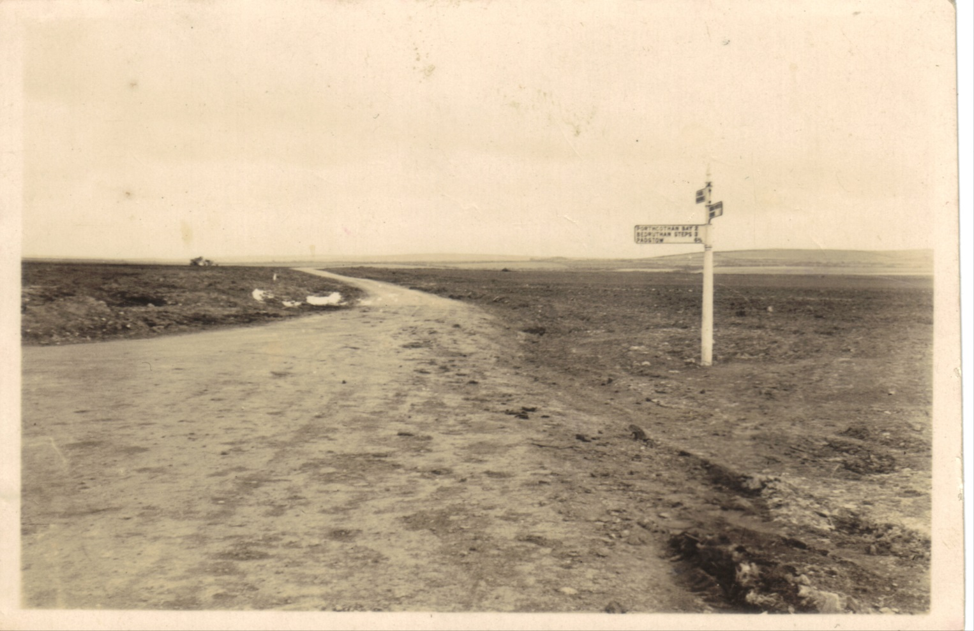
St Eval Crossroads after demolition of the Village 1938

Slide 10
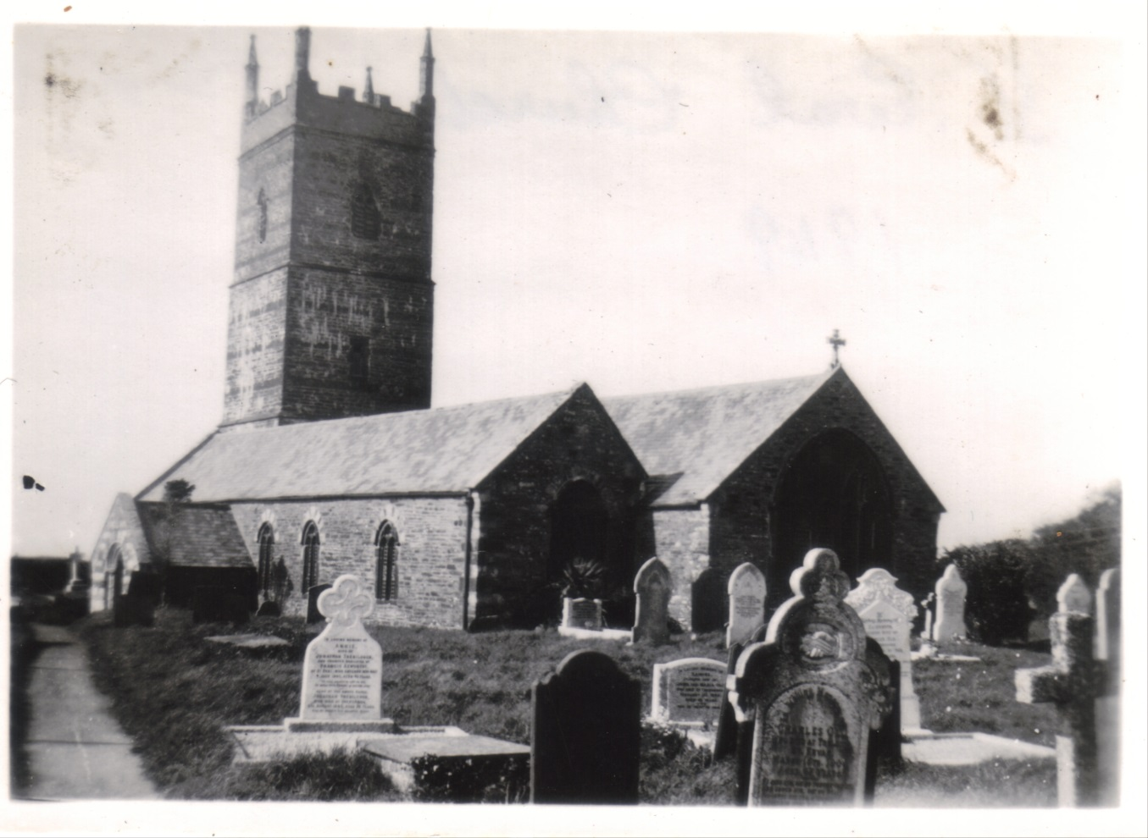
St Eval Church

Slide 11
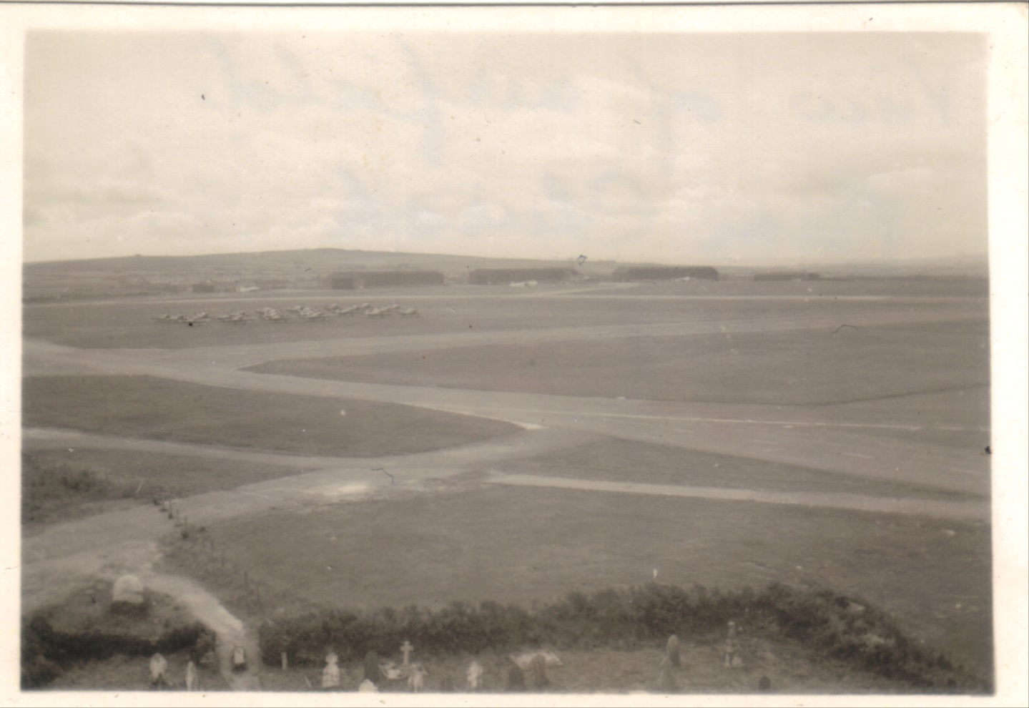
St Eval Airfield from the church tower

Slide 12
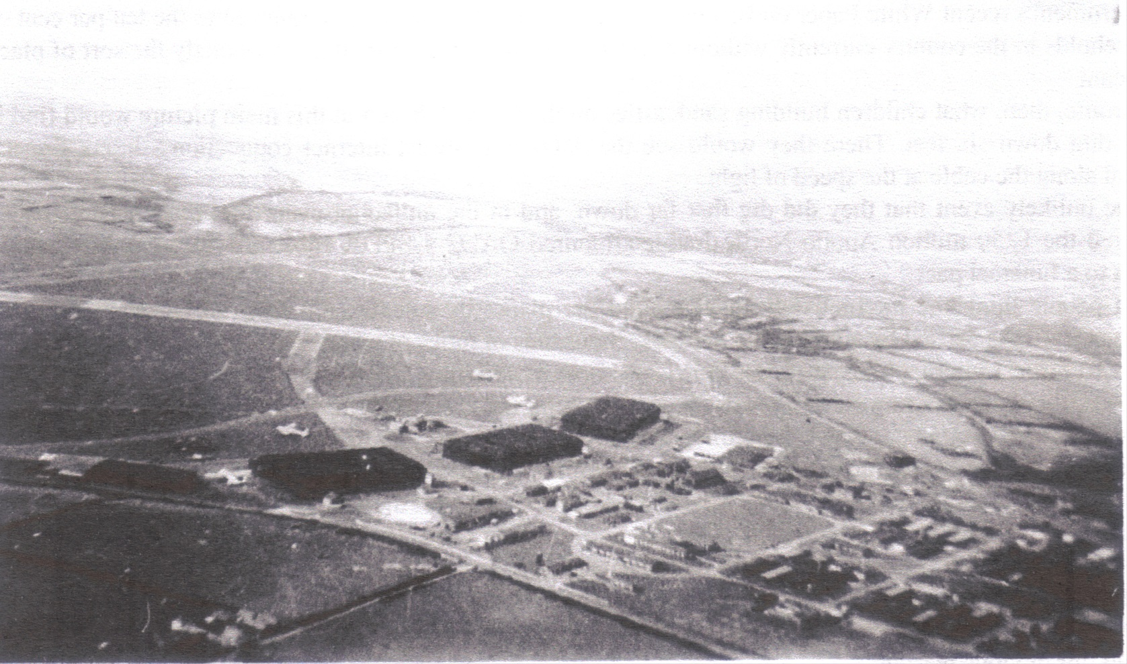
Aerial view of St Eval with hangers

Slide 13
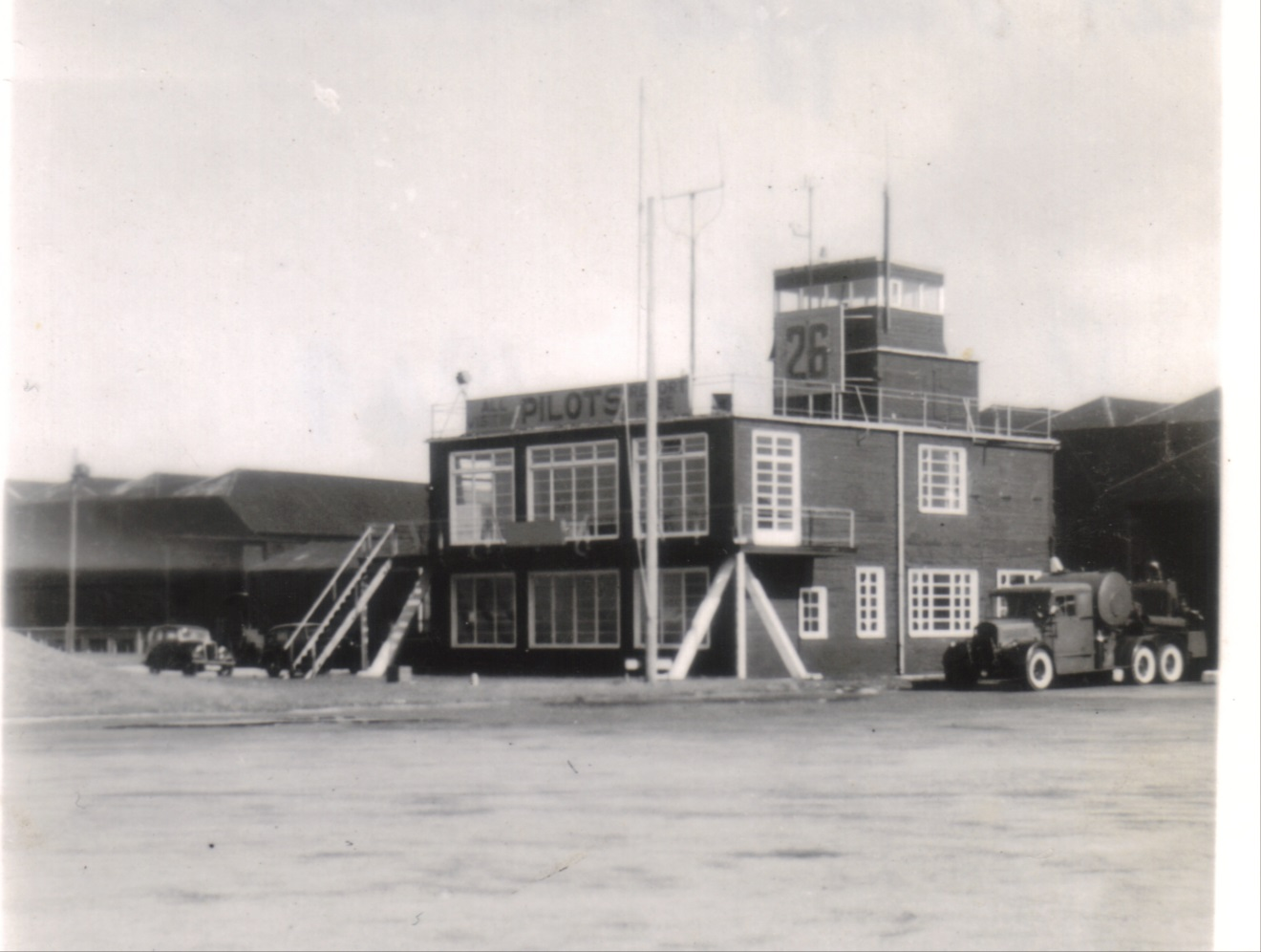
Wooden control tower at St Eval

Slide 14
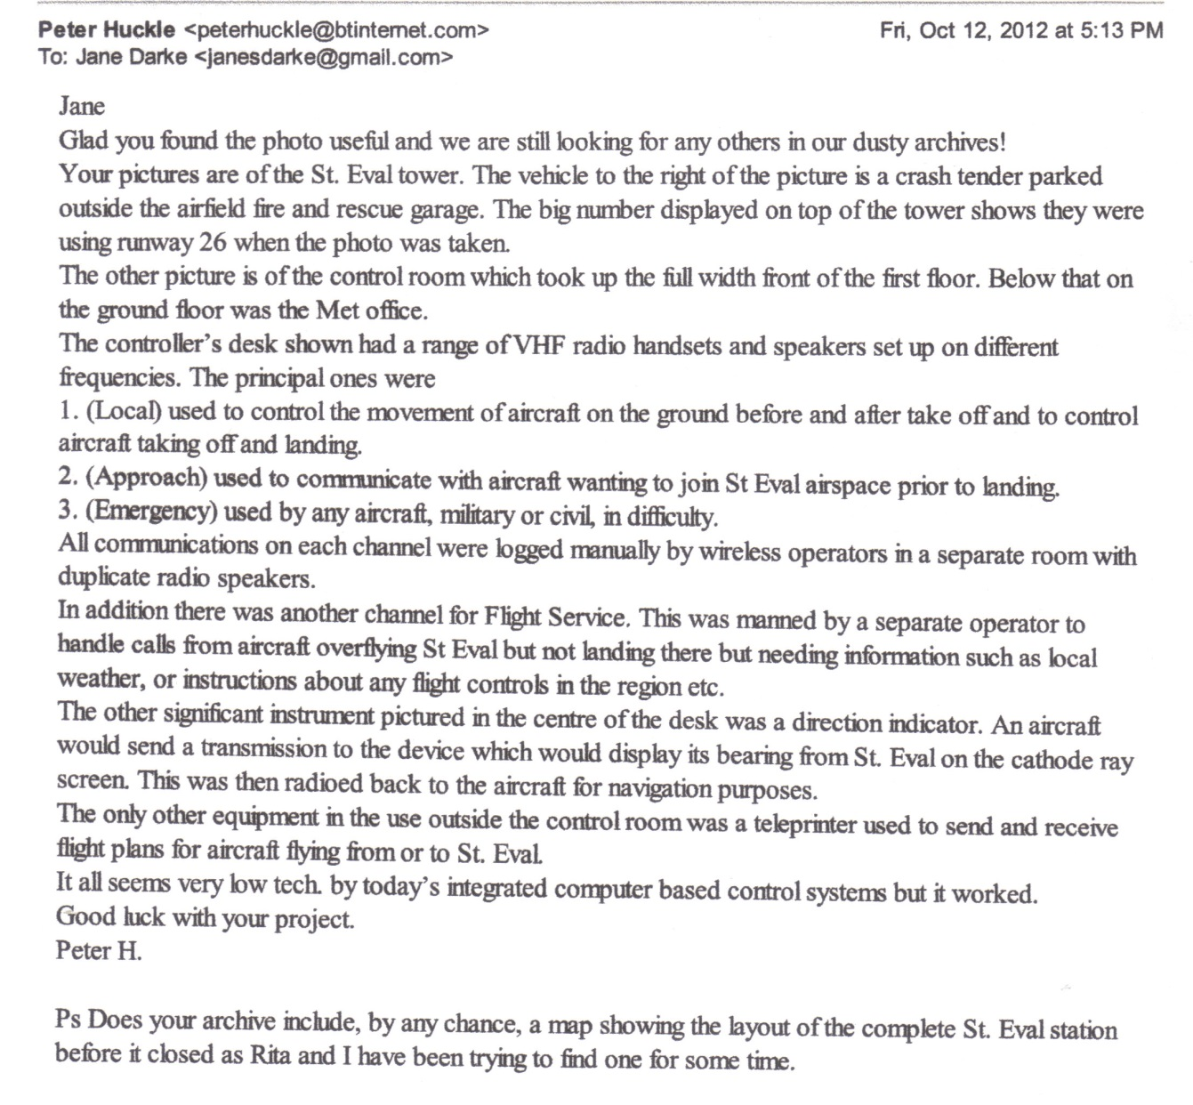
Account by Peter Huckle of working practice in the control tower

Slide 15
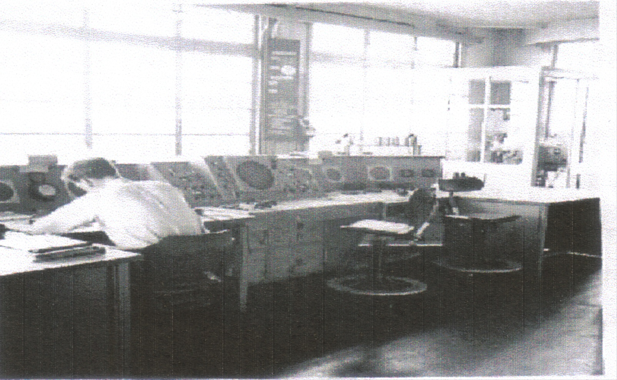
Air traffic Control tower interior.

Slide 16
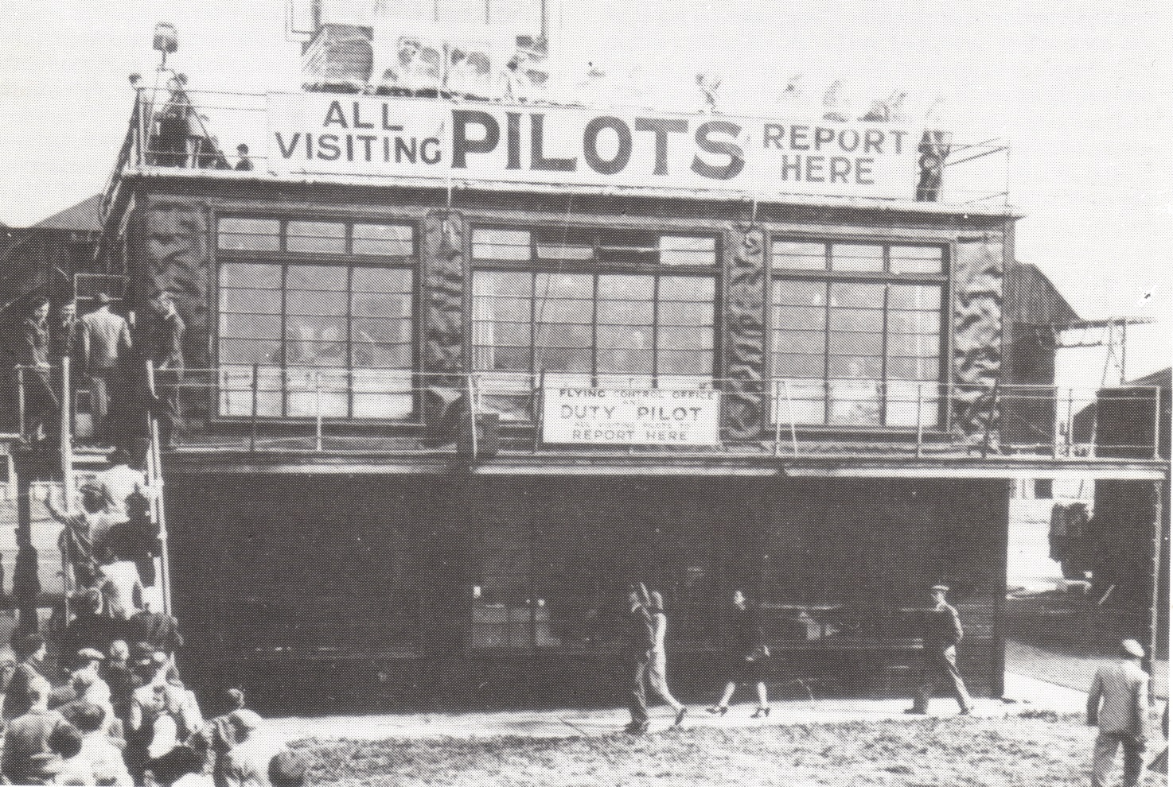
St Eval Control tower- wood covered with tarred felt. Battle of Britain Day 1946 –open to the public

Slide 17
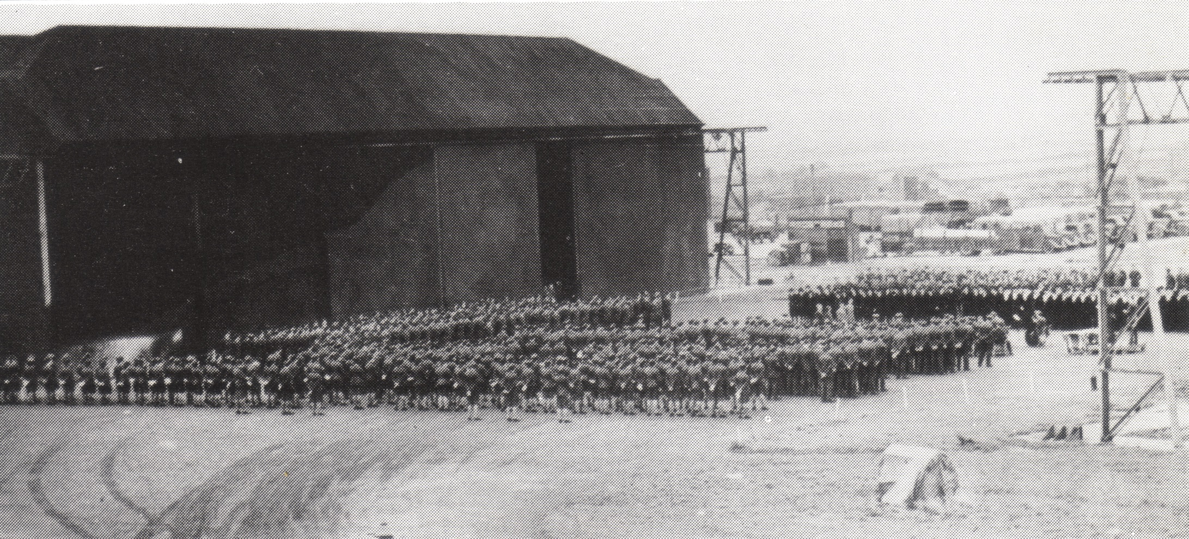
C Type Hangar no.2 from Control tower. Battle of Britain Parade 1946

Slide 18
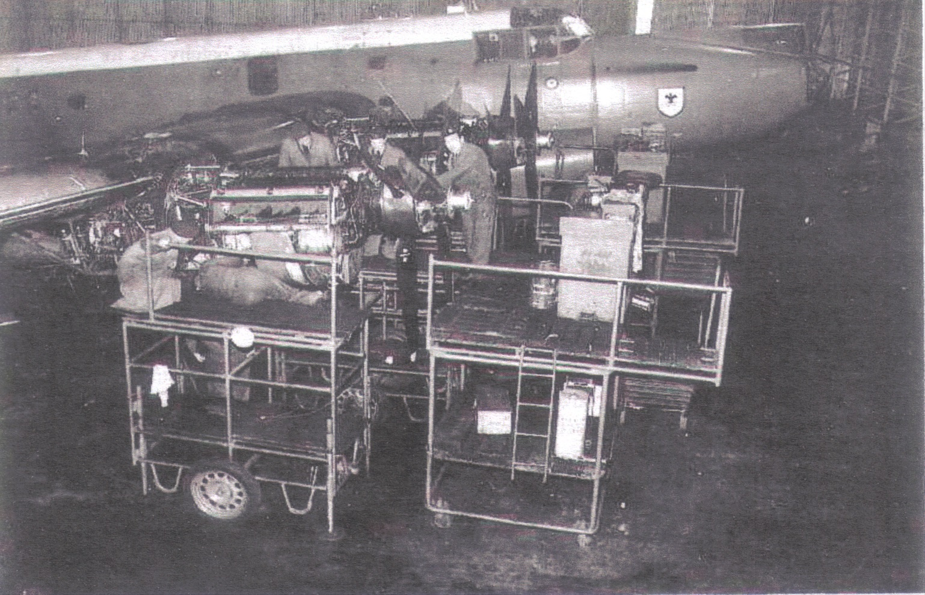
Inside ASF (Aircraft Servicing Flight) Hanger St Eval

Slide 19
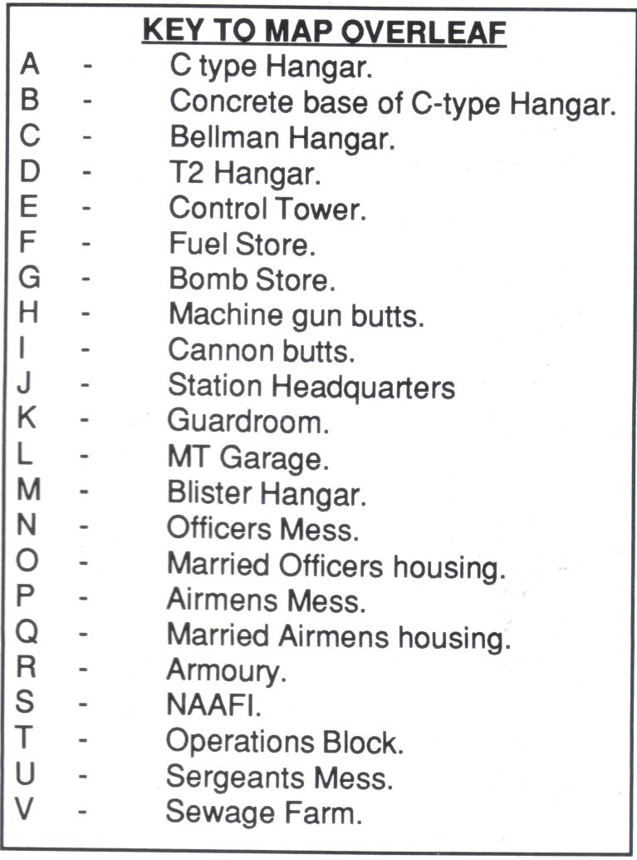
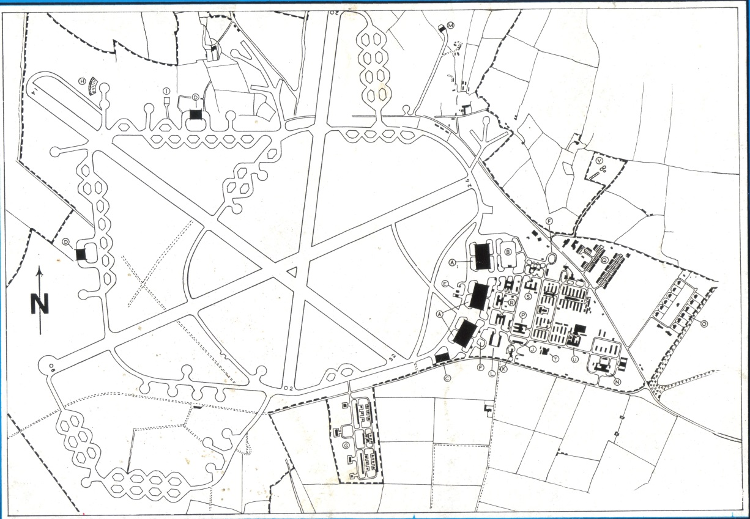
Map of St Eval Airfield

Slide 20
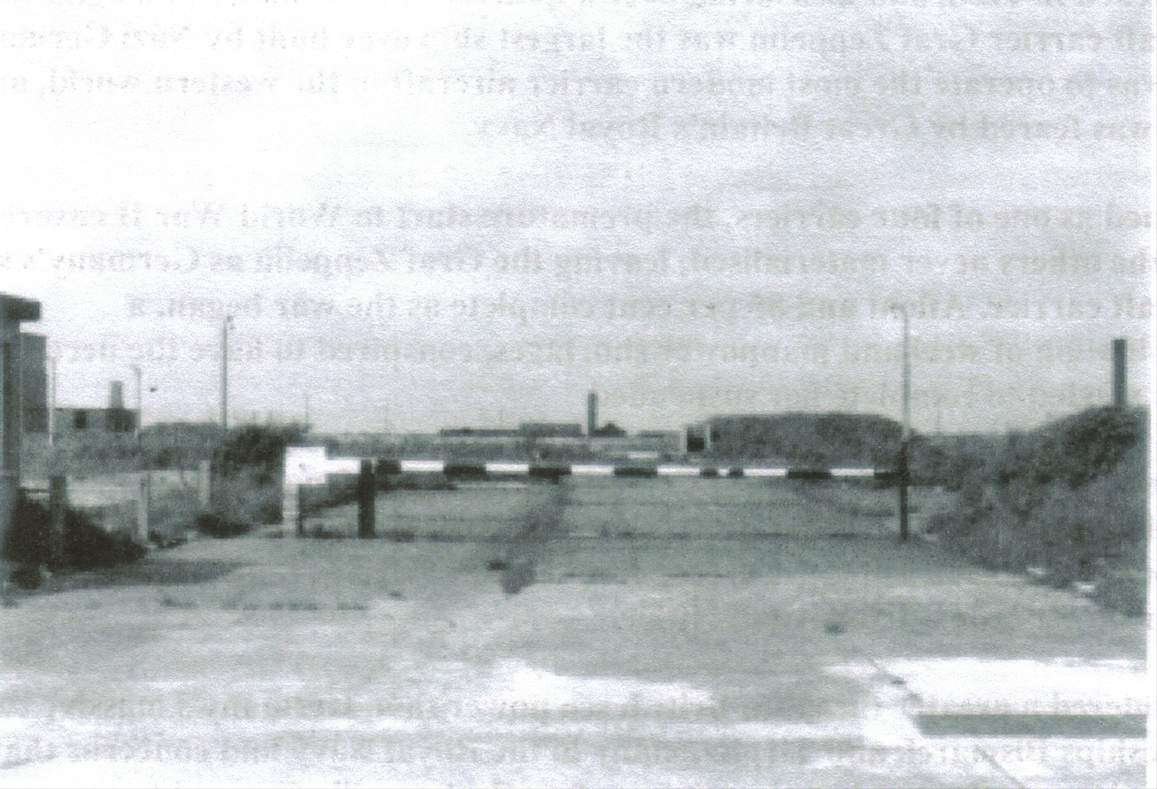
St Eval Main Gate

Slide 21
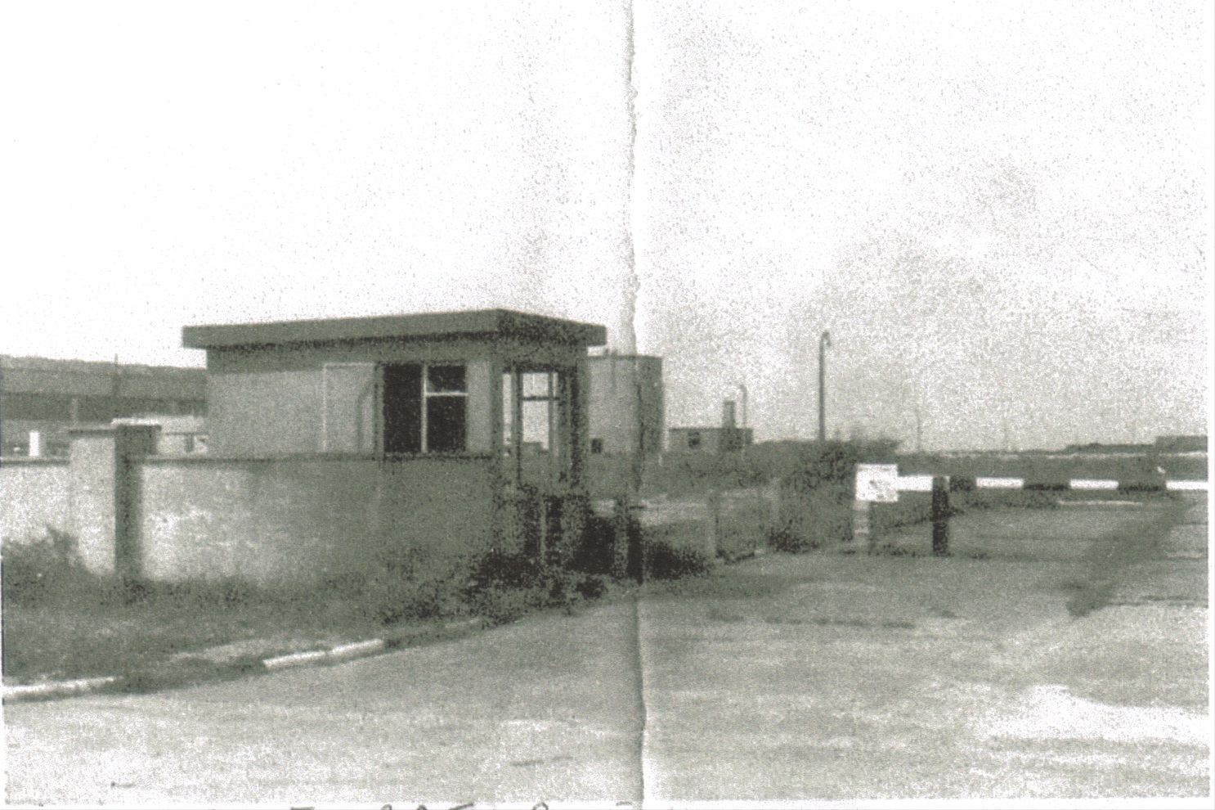
St Eval Main Gate

Slide 22
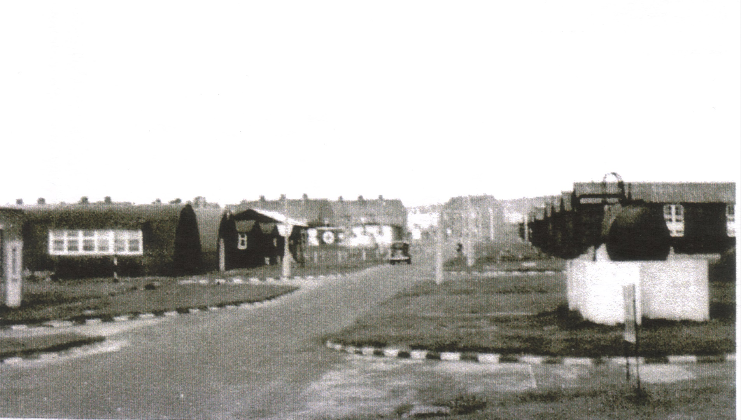
St Eval quarters C6 opposite sick bay

Slide 23
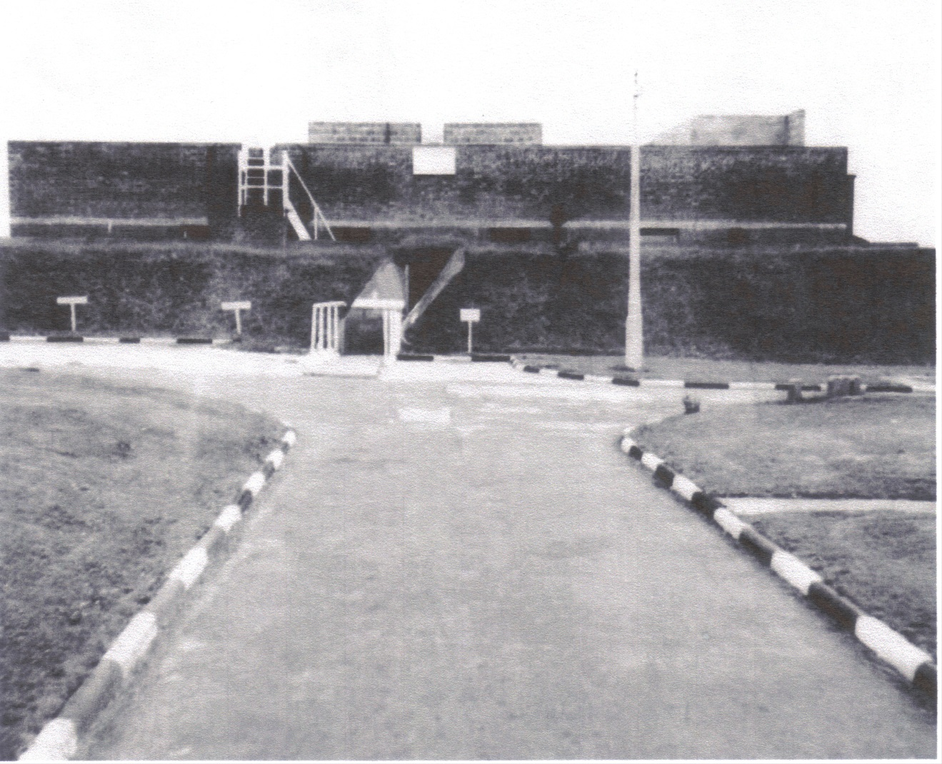
St Eval Operations Block

Slide 24
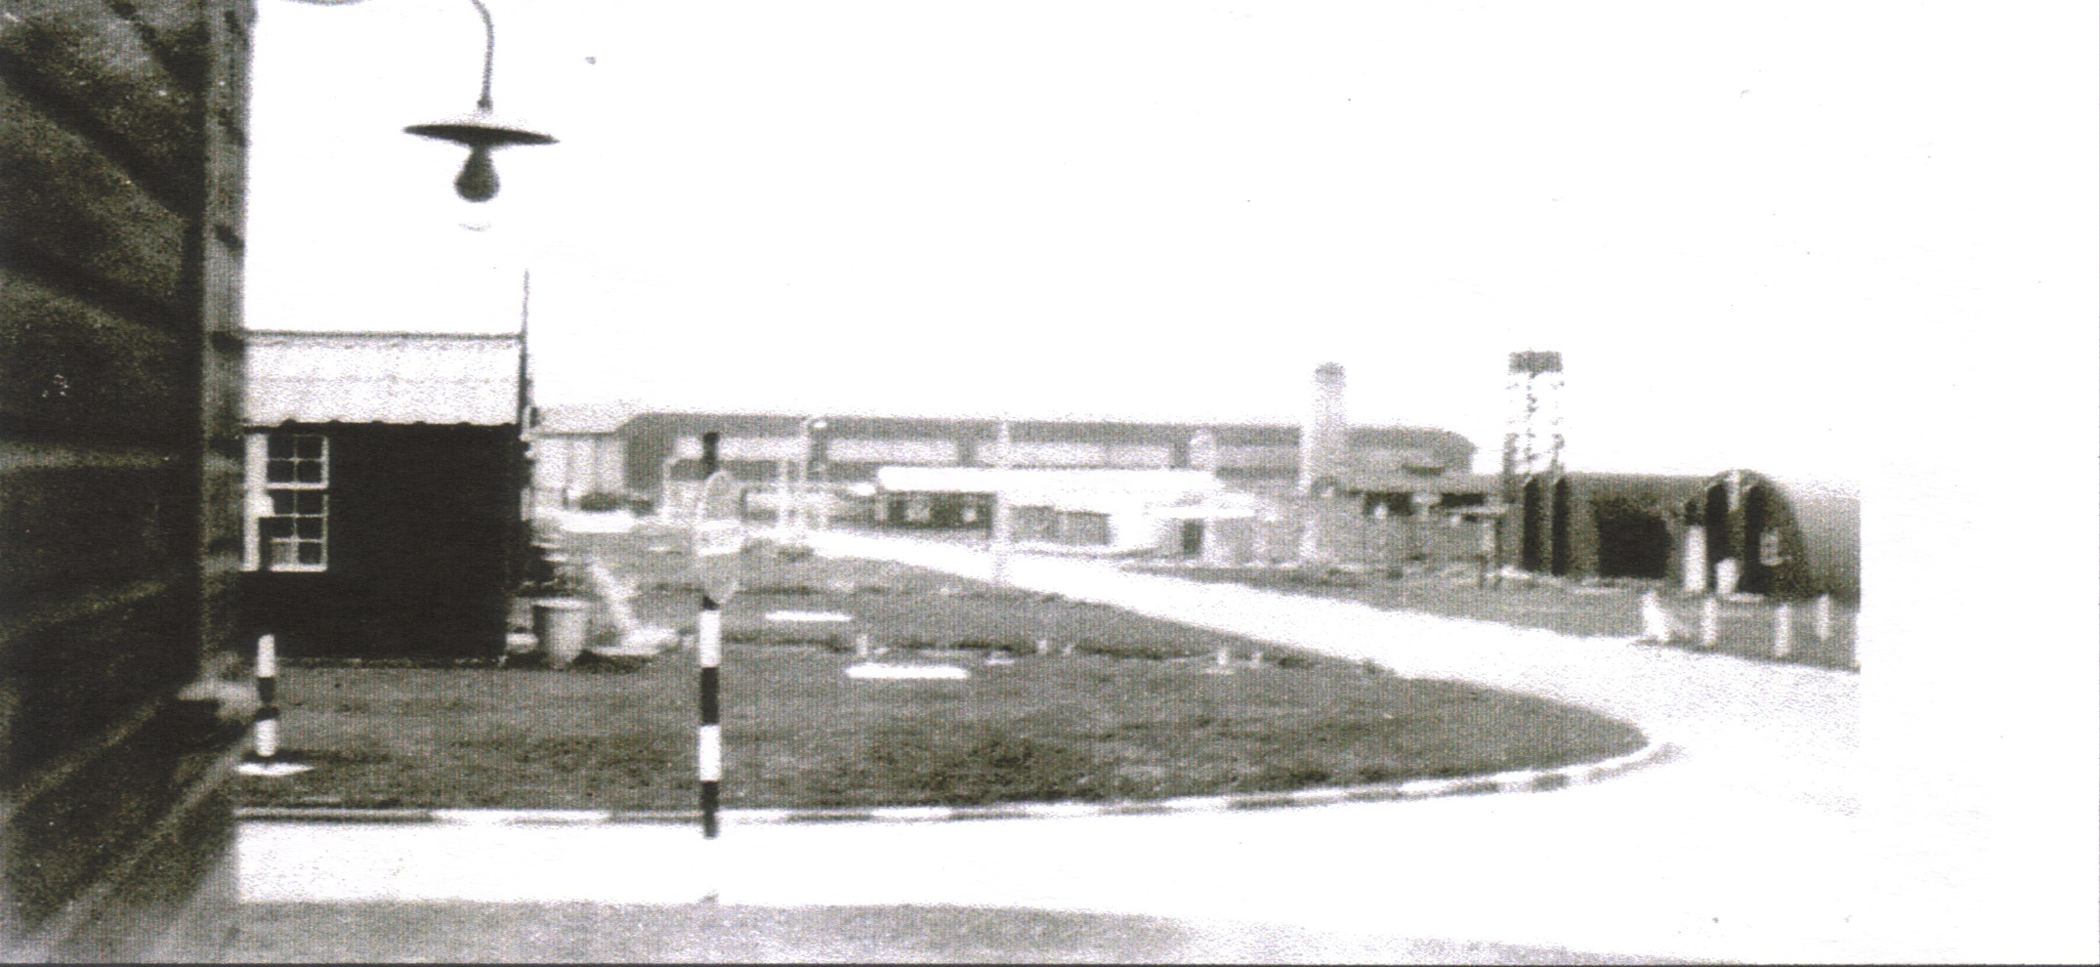
St Eval towards hangar and C Block

Slide 25
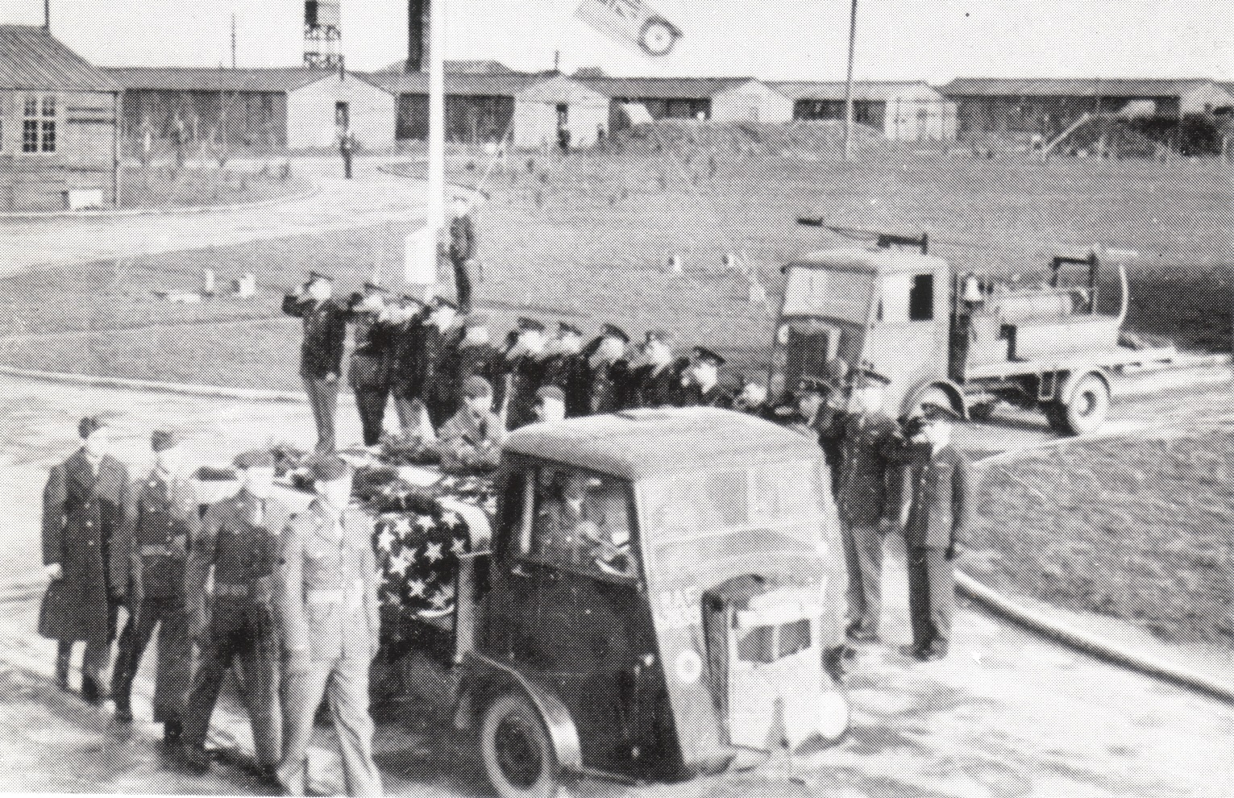
Funeral of American airman. Opposite main gate and guard room, wooden accommodation huts behind

Slide 26
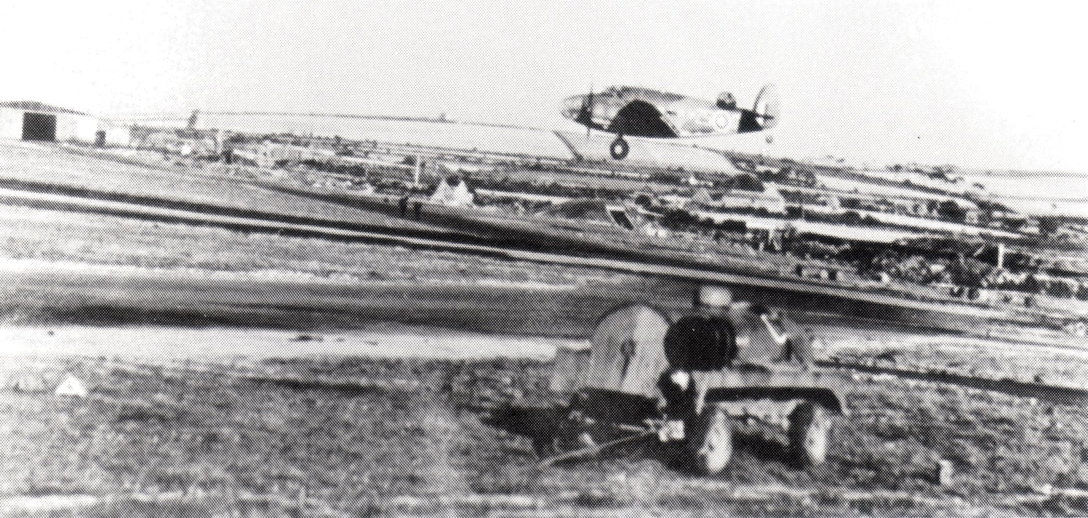
Hudson of 233 Squadron on runway 02 St Eval, Bellman Hangar in background

Slide 27
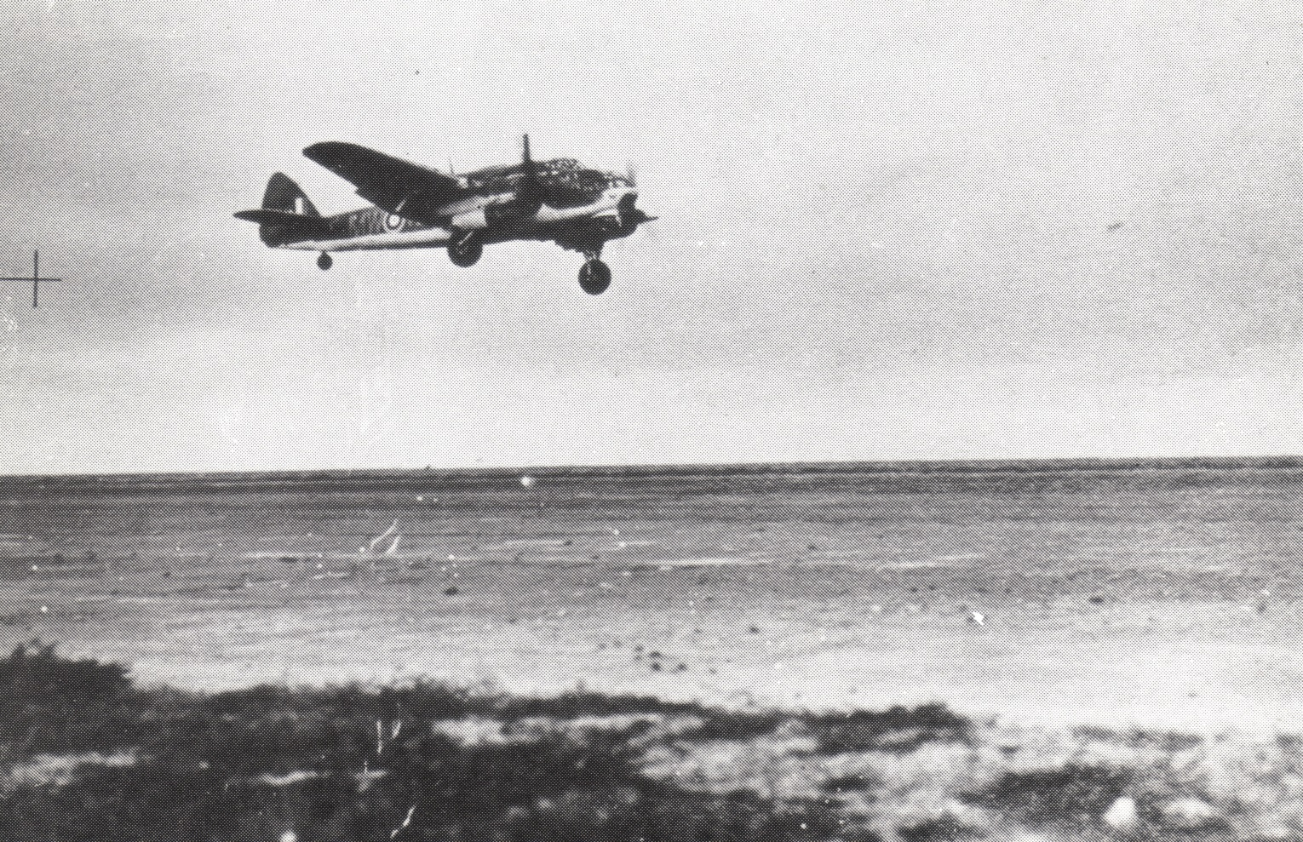
Beaufort 217 Squadron St Eval 1942

Slide 28
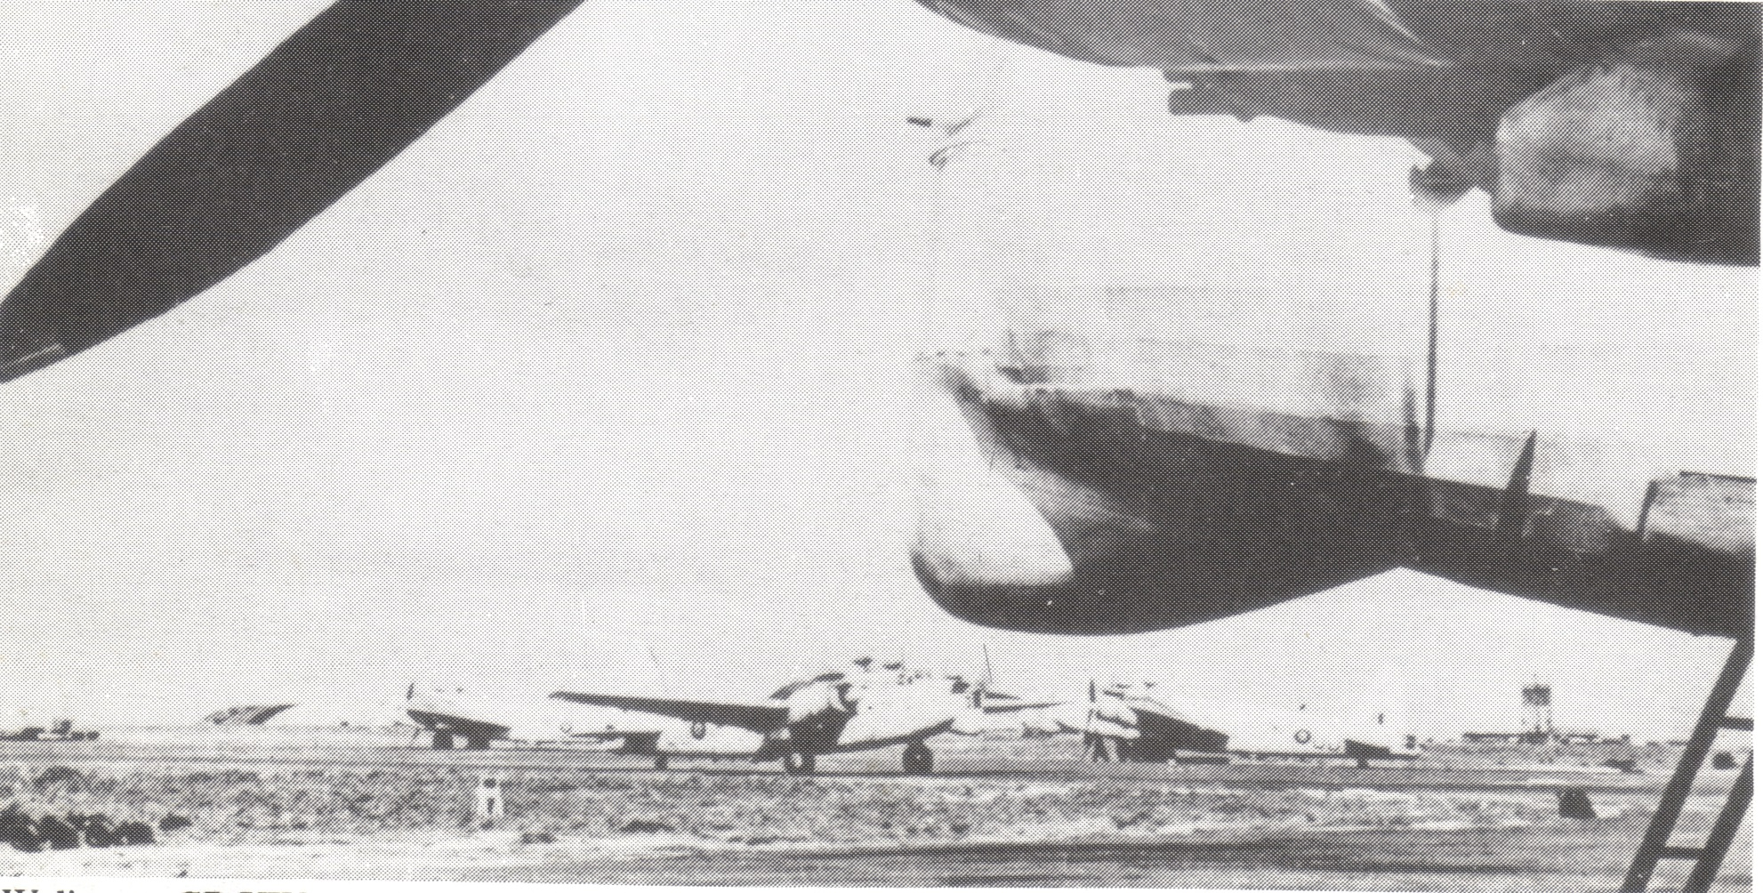
Wellington Gr XIV’s of 304 (Polish) squadron on dispersal 1945. Blister hangar in back ground

Slide 29
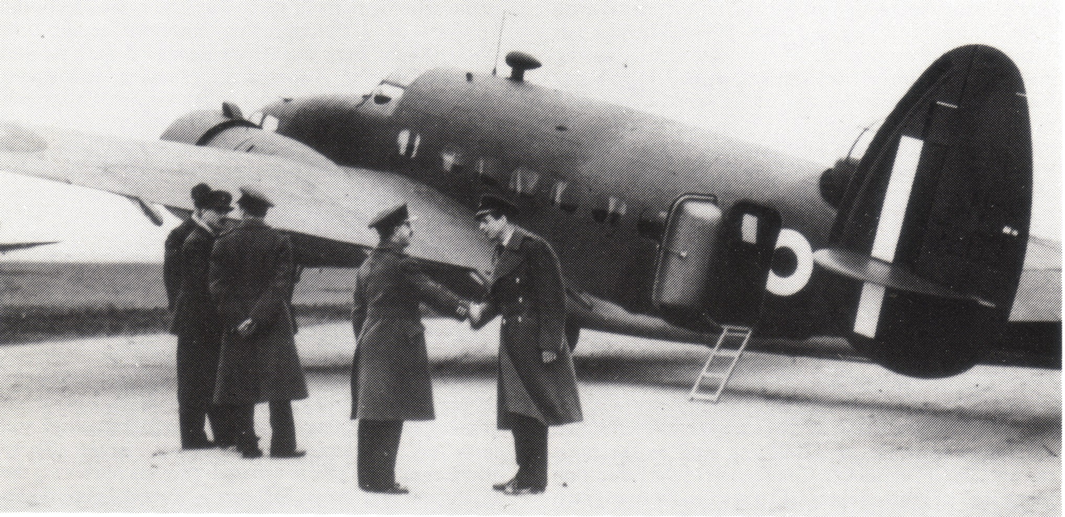
Group Captain HRH Duke of Kent greeted by Station Commander Group Captain A.P.Revington March 14th 1941

Slide 30
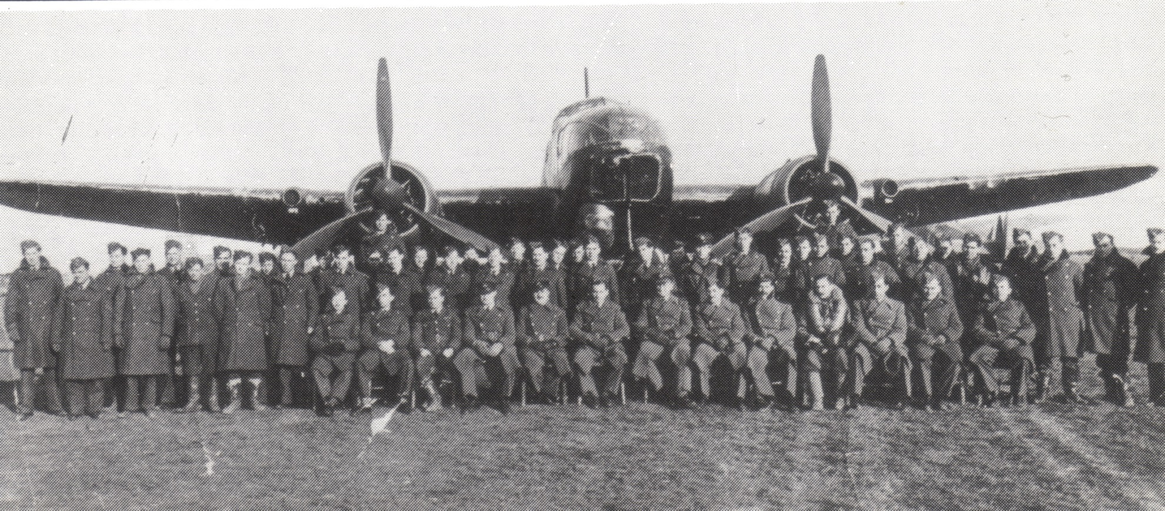
Air and ground crew 217 Squadron in front of a Beaufort

Slide 31
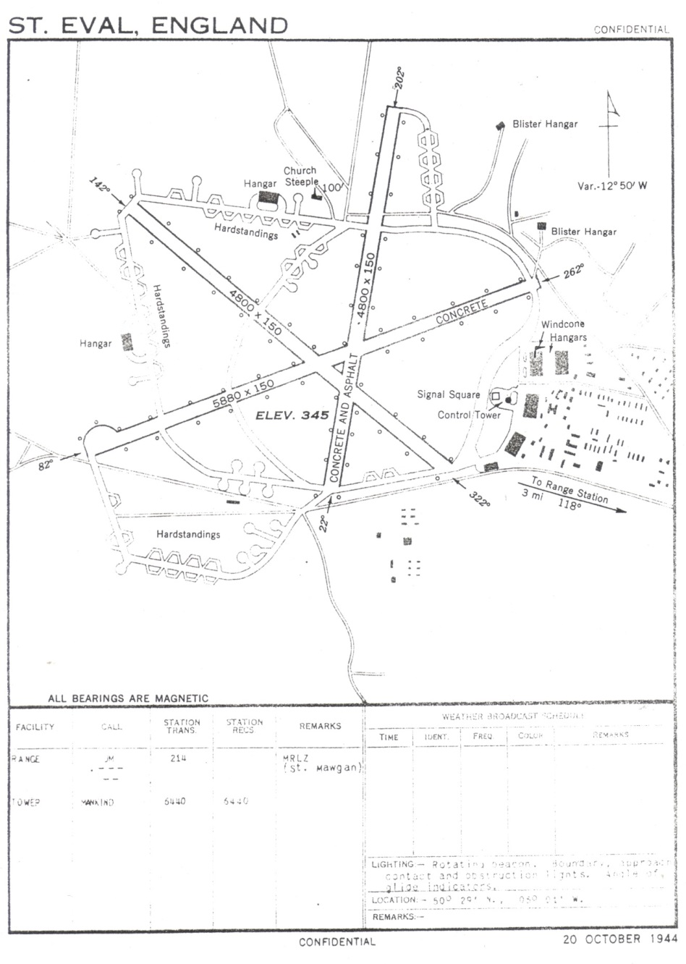
Map of St Eval Oct 20th 1944

Slide 32
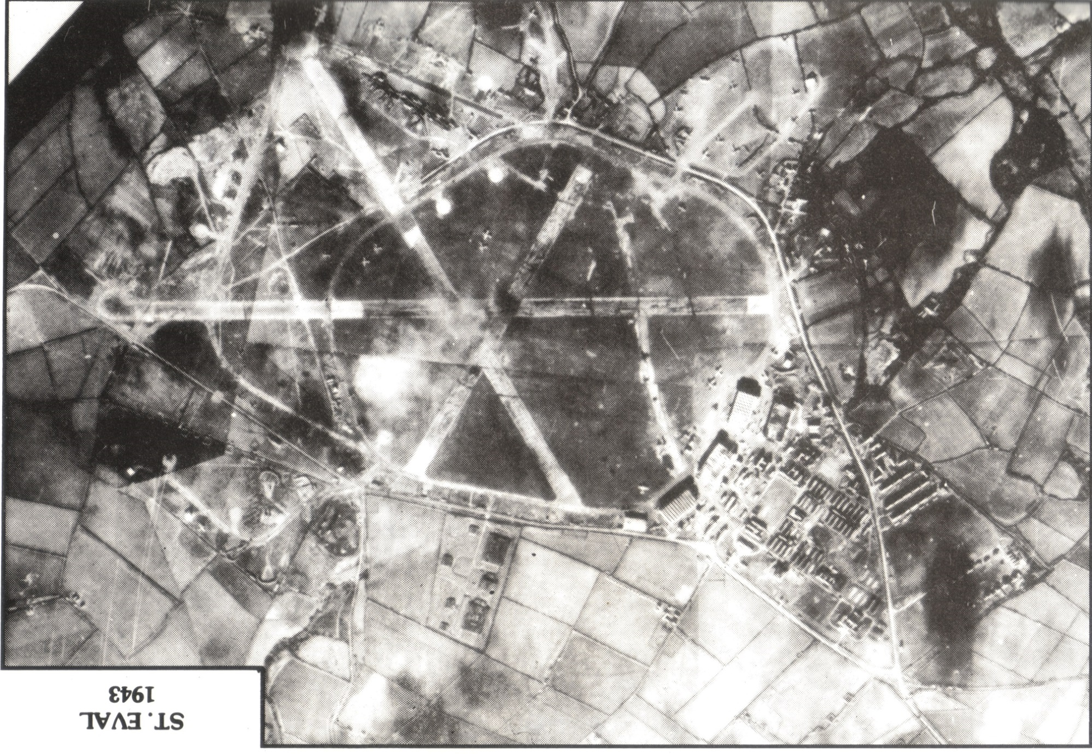

Slide 33
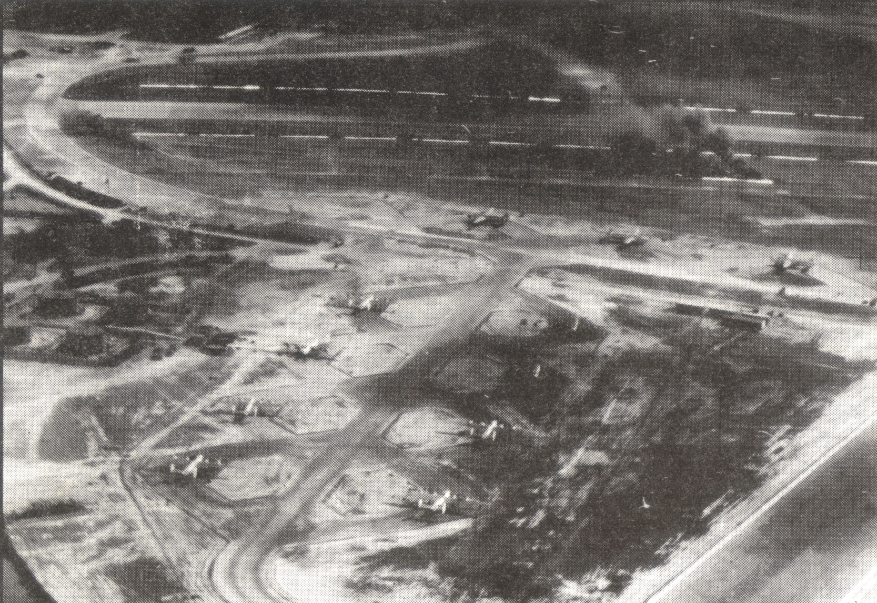
224 squadron Liberators on dispersal

Slide 34
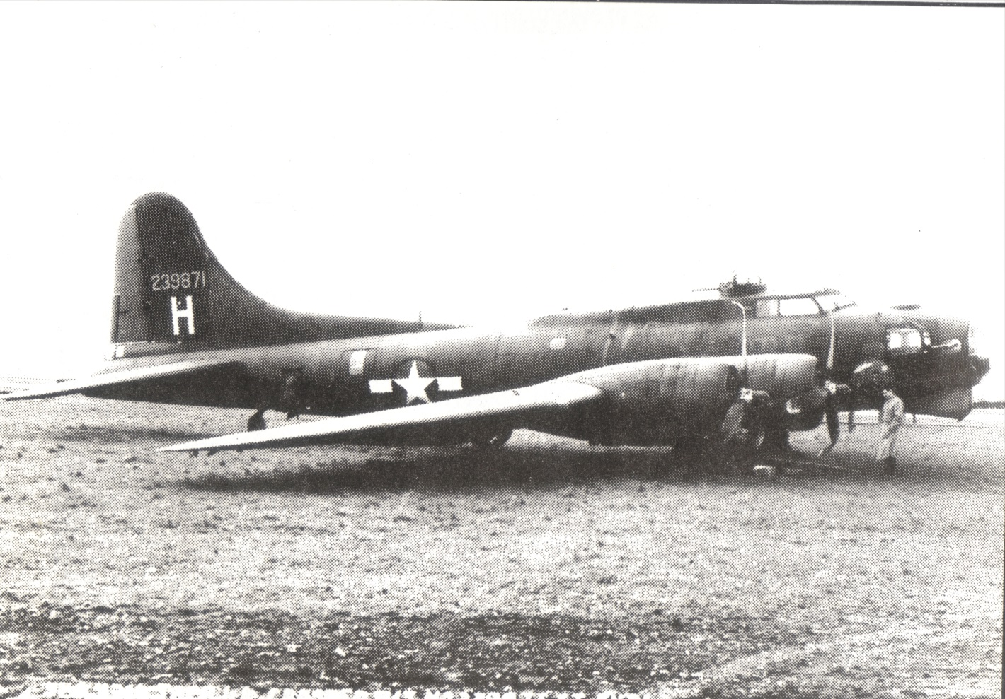
B17 at St Eval after daylight blitz Brest

Slide 35
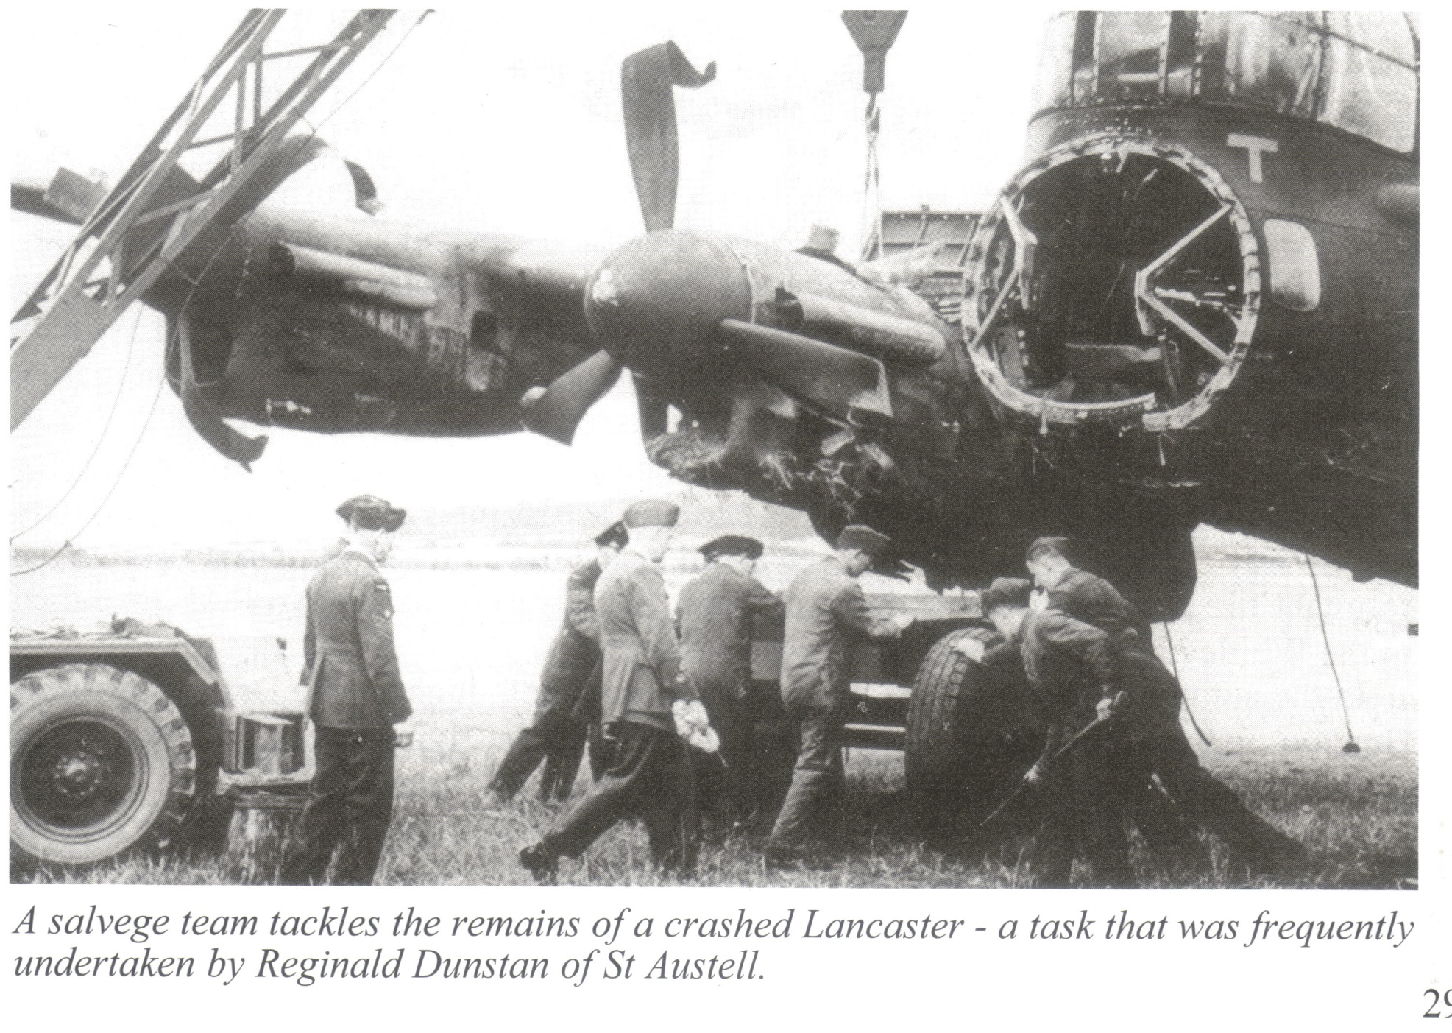

Slide 36
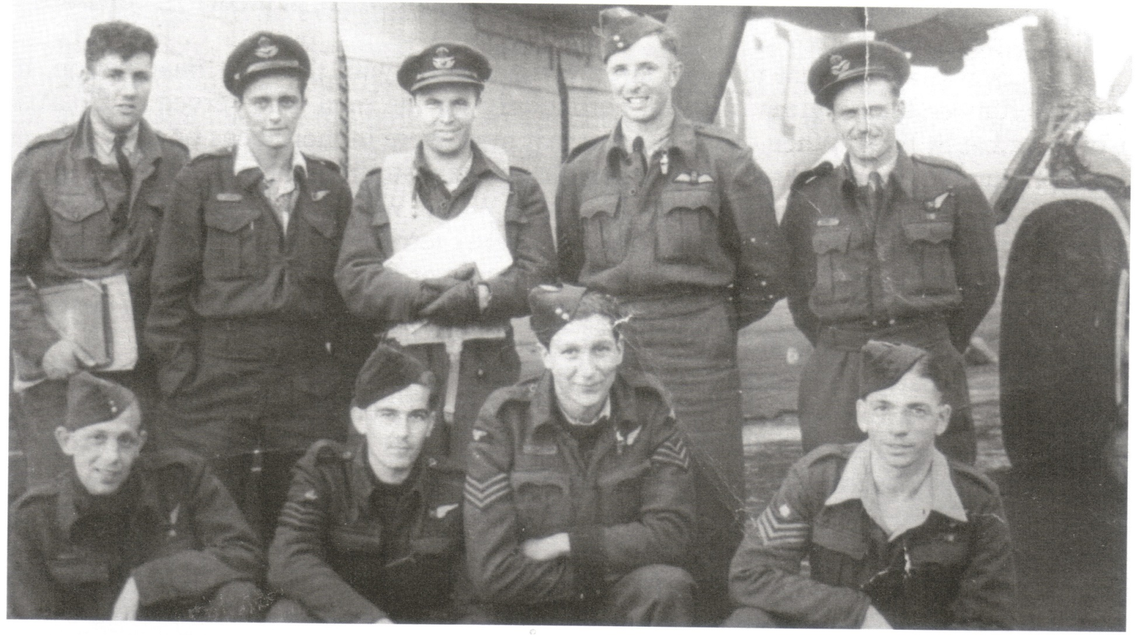

Slide 37
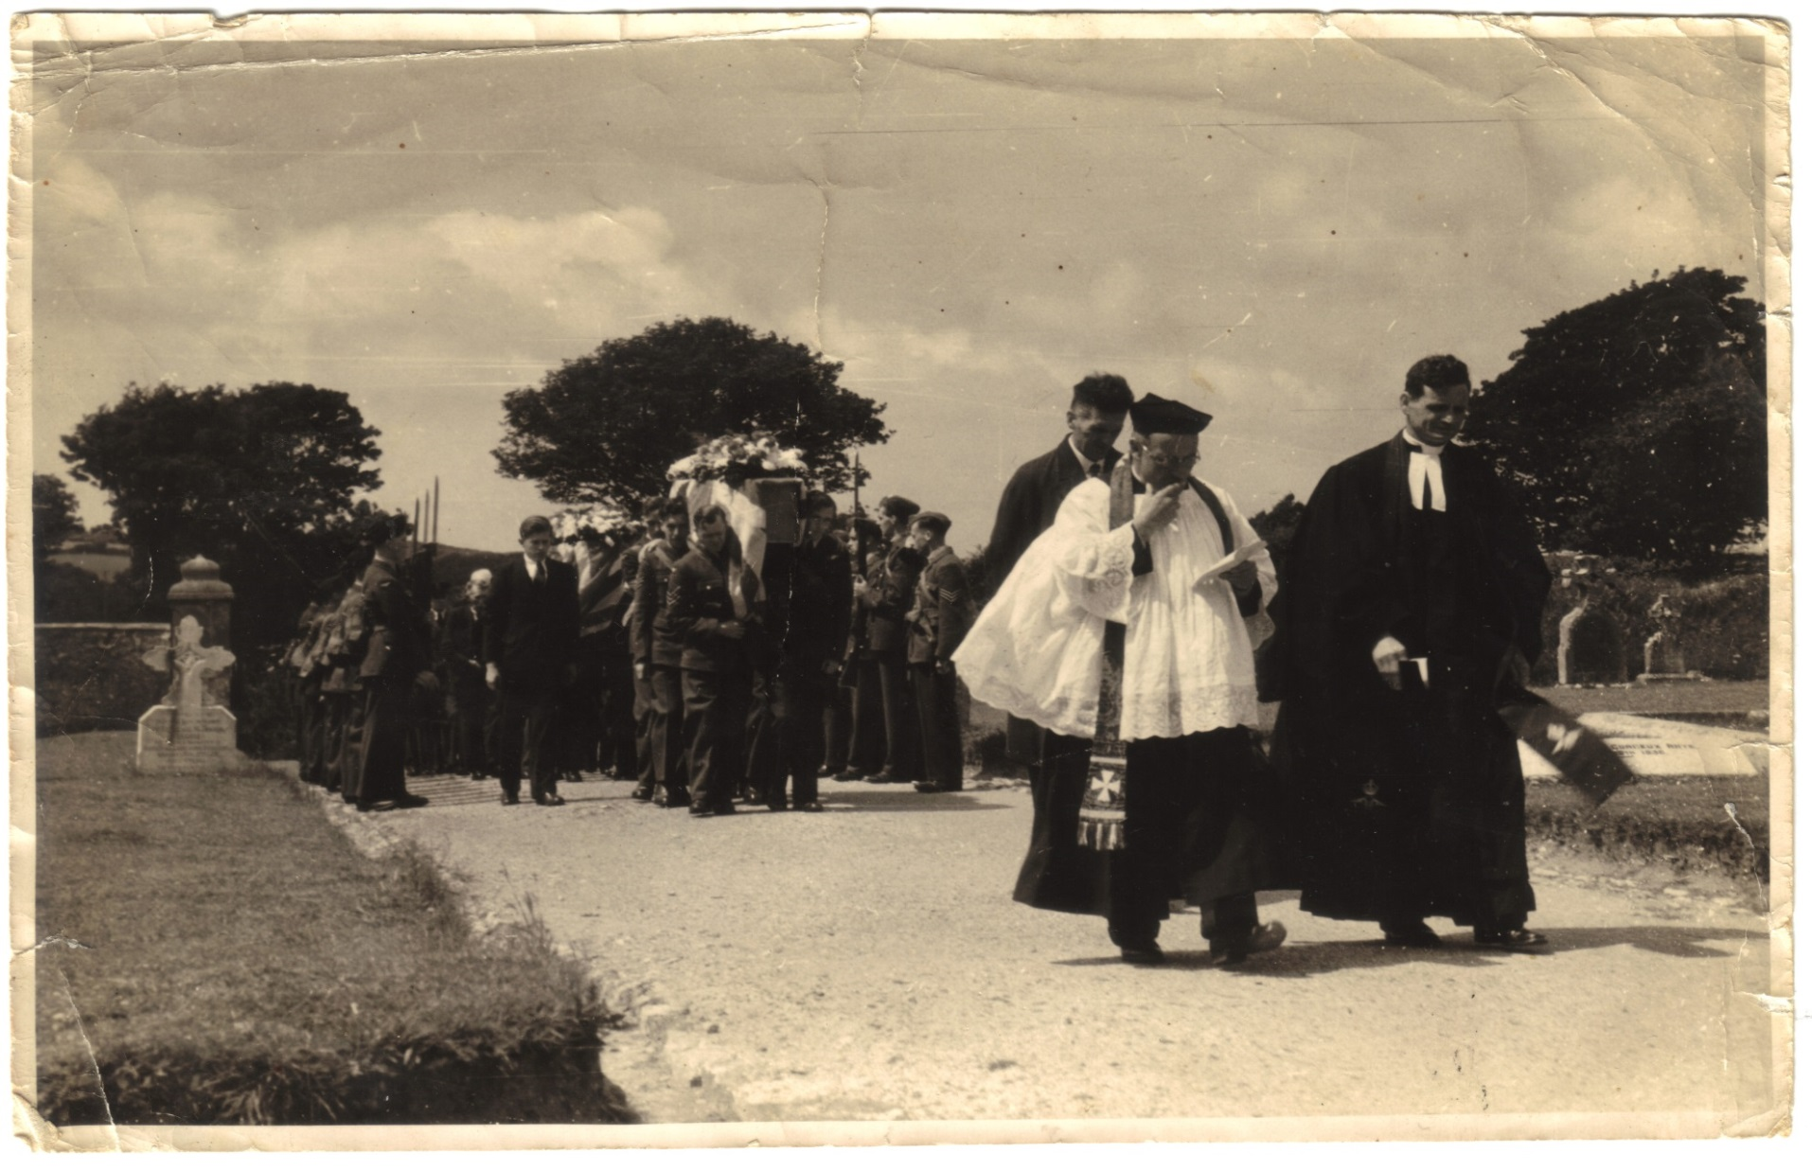
RAF funeral August 6th 1942. Revd. Jolly of St Eval, Squadron Leader Revd. Pashley, St Colomb Major Cemetery

Slide 38
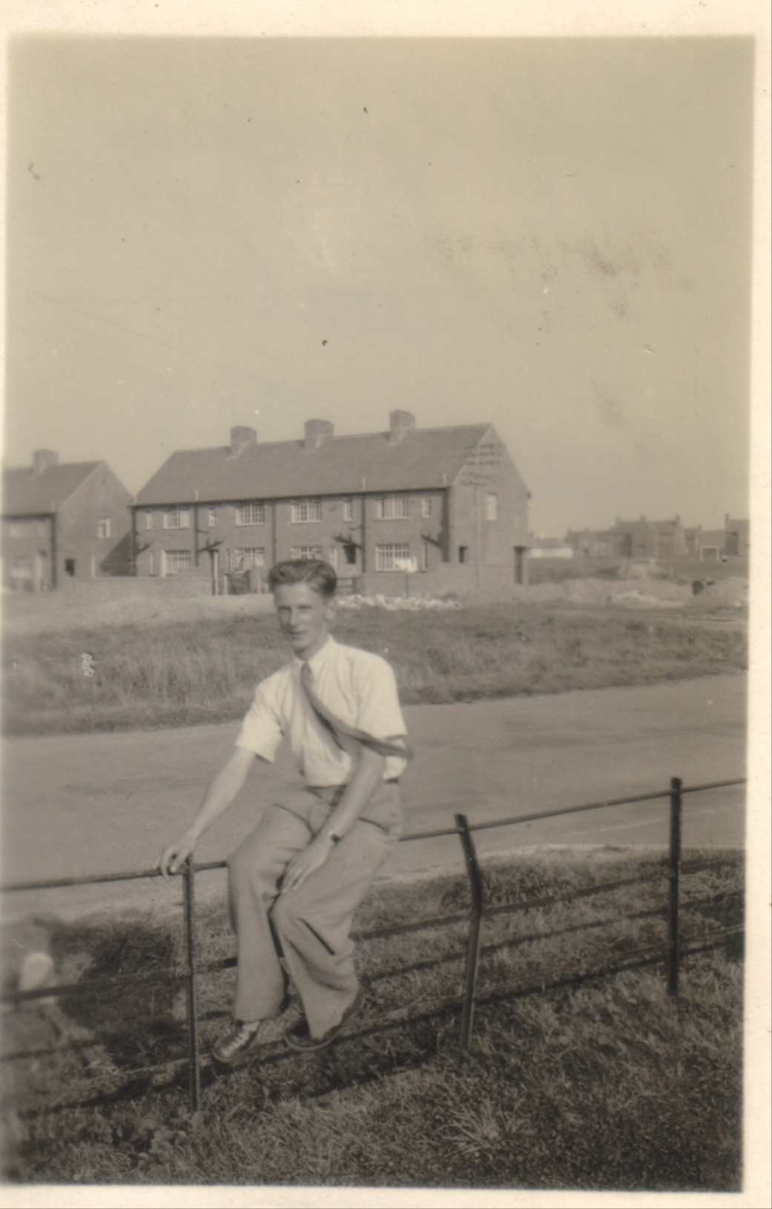

Slide 39
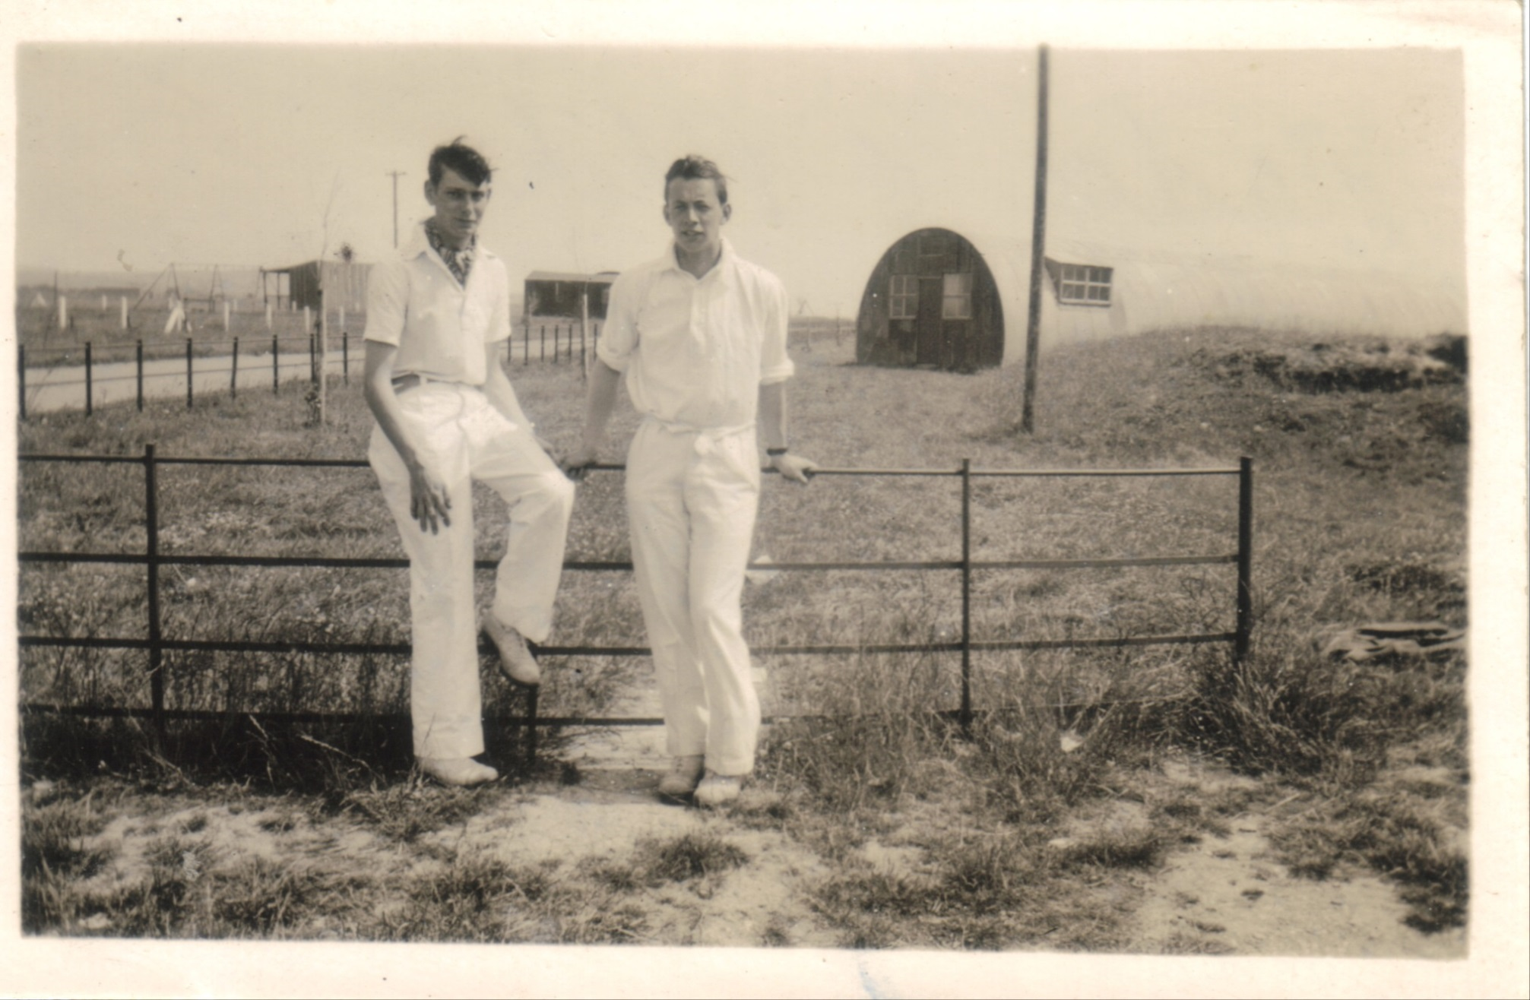

Slide 40
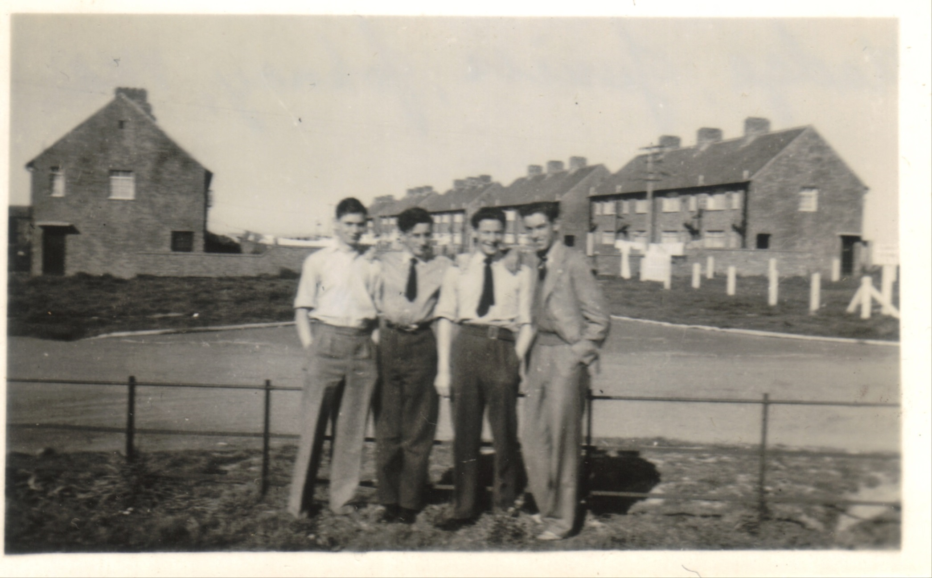

Slide 41
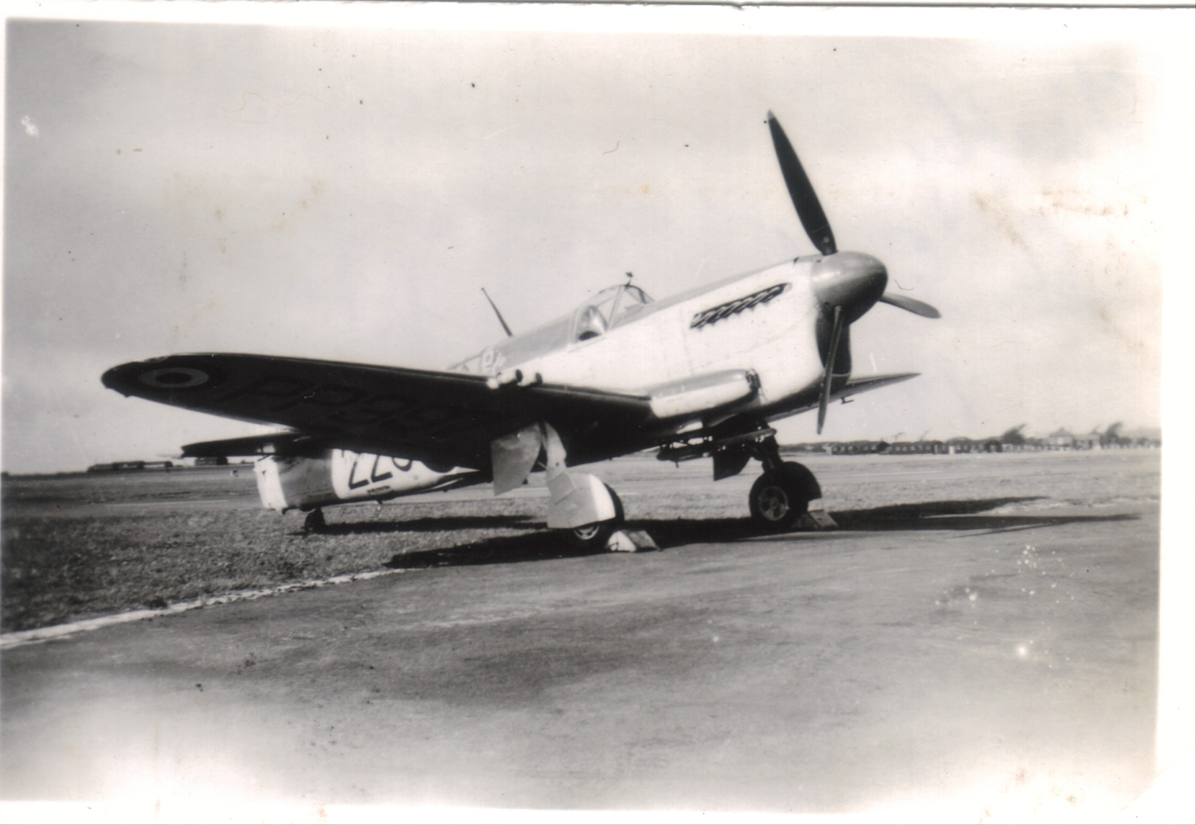
Sea Fire St Eval

Slide 42
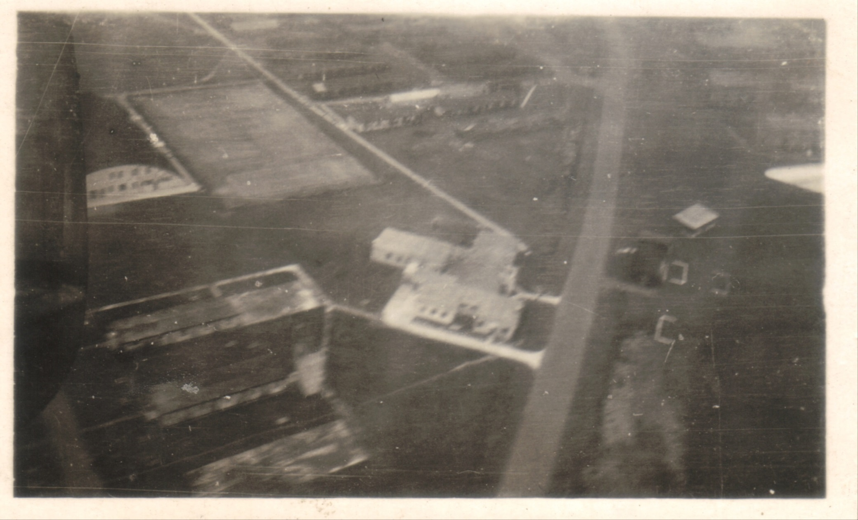

Slide 43
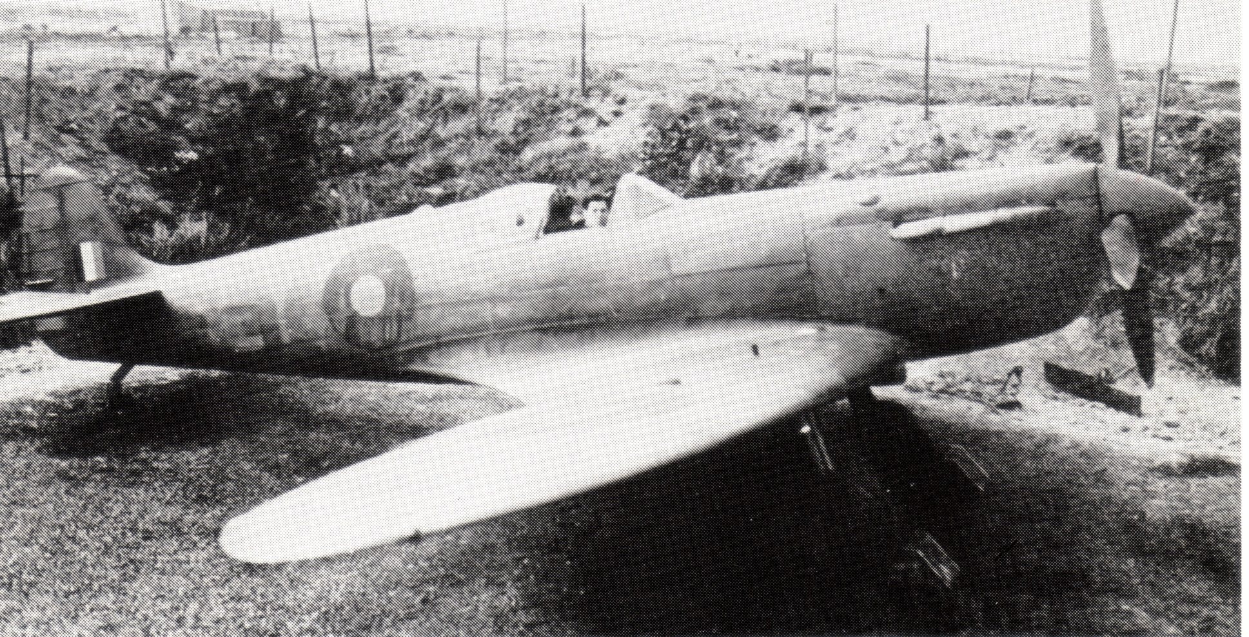
Spitfire St Eval

Slide 44
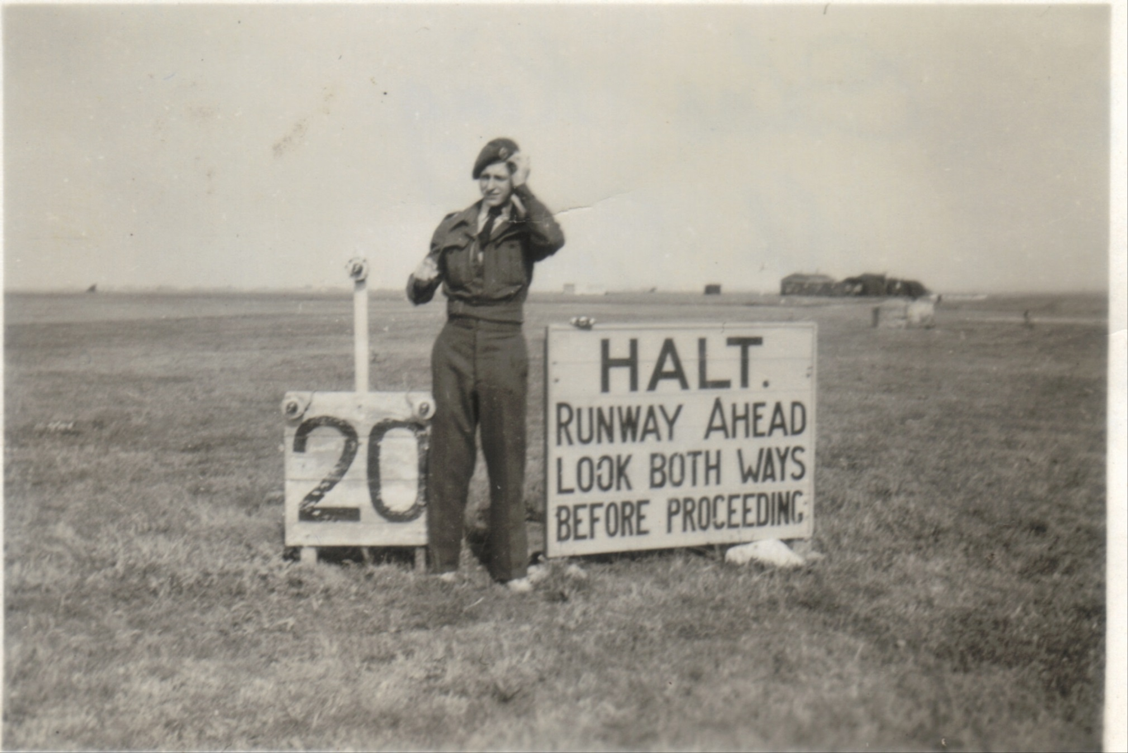

Slide 45
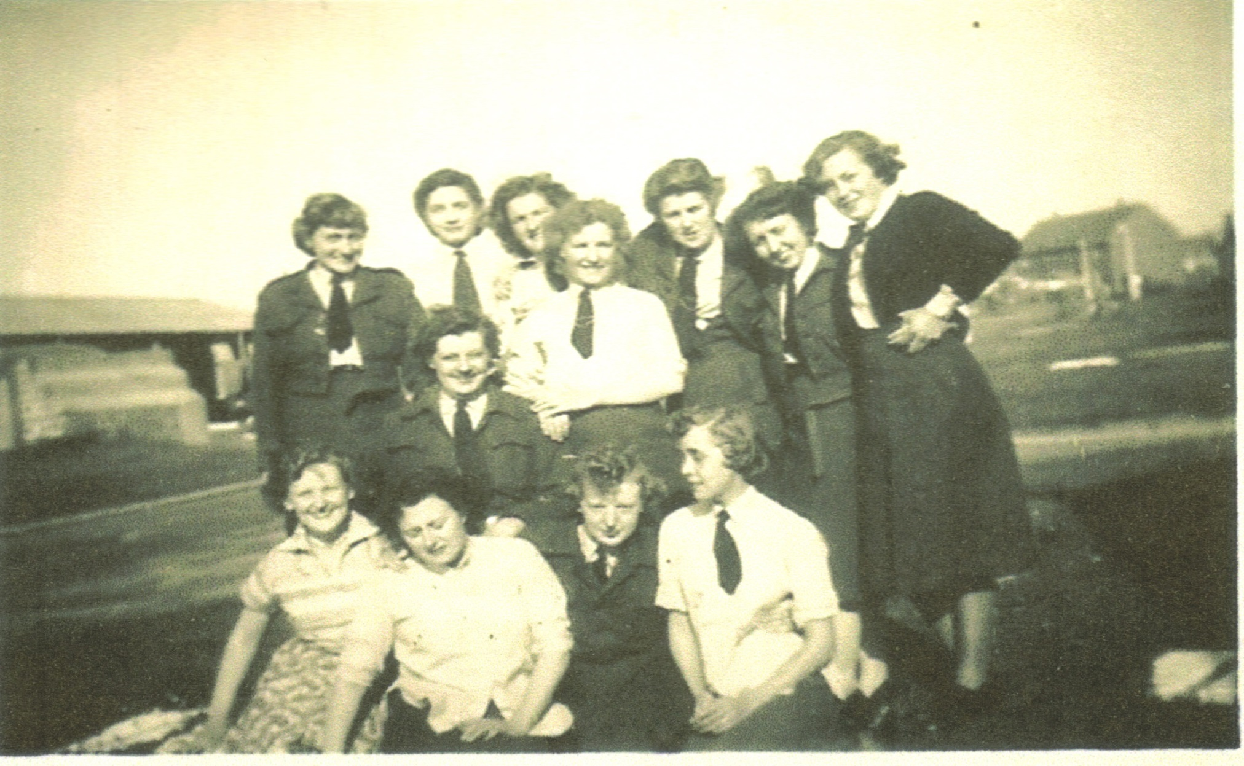

Slide 46
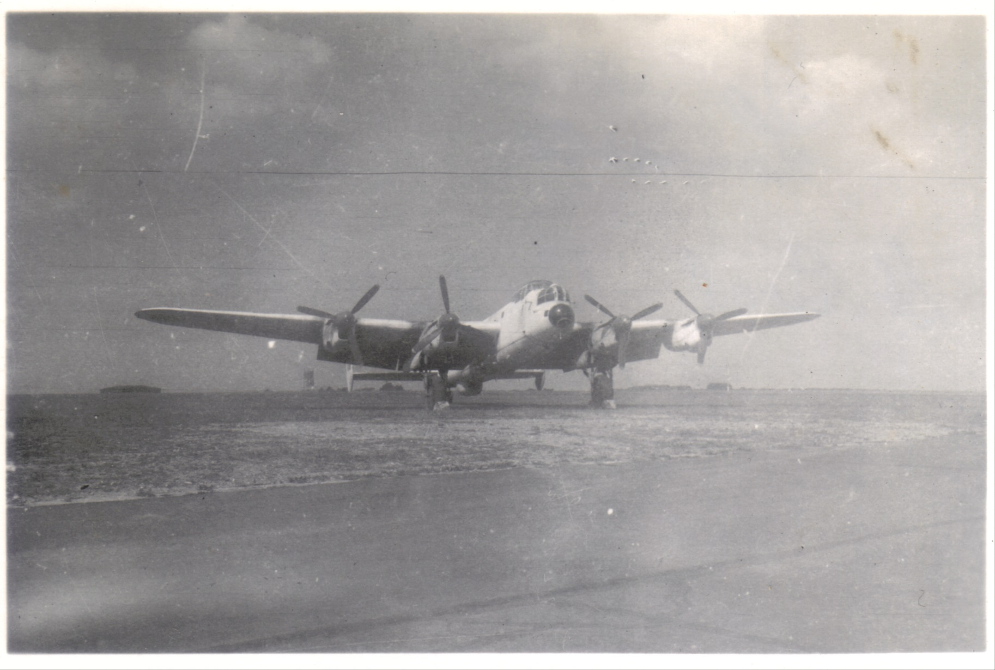
Lancaster

Slide 47
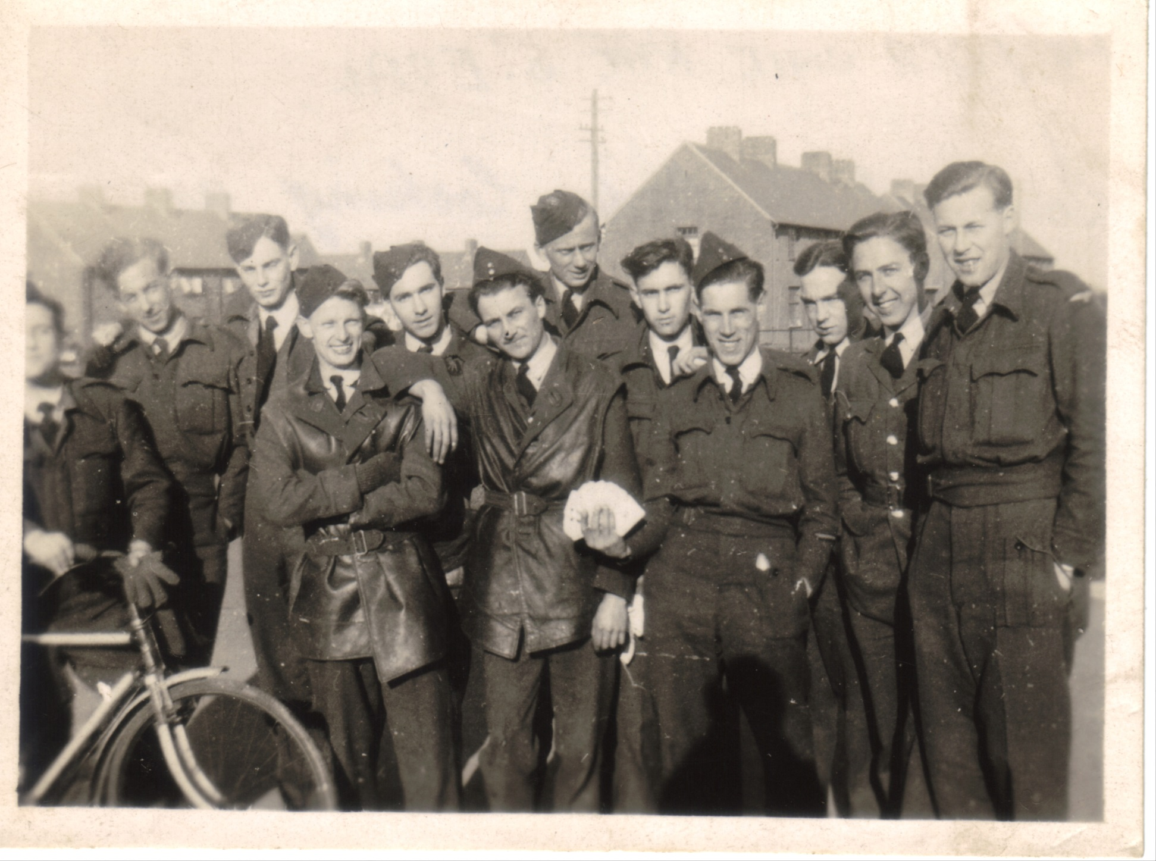

Slide 48
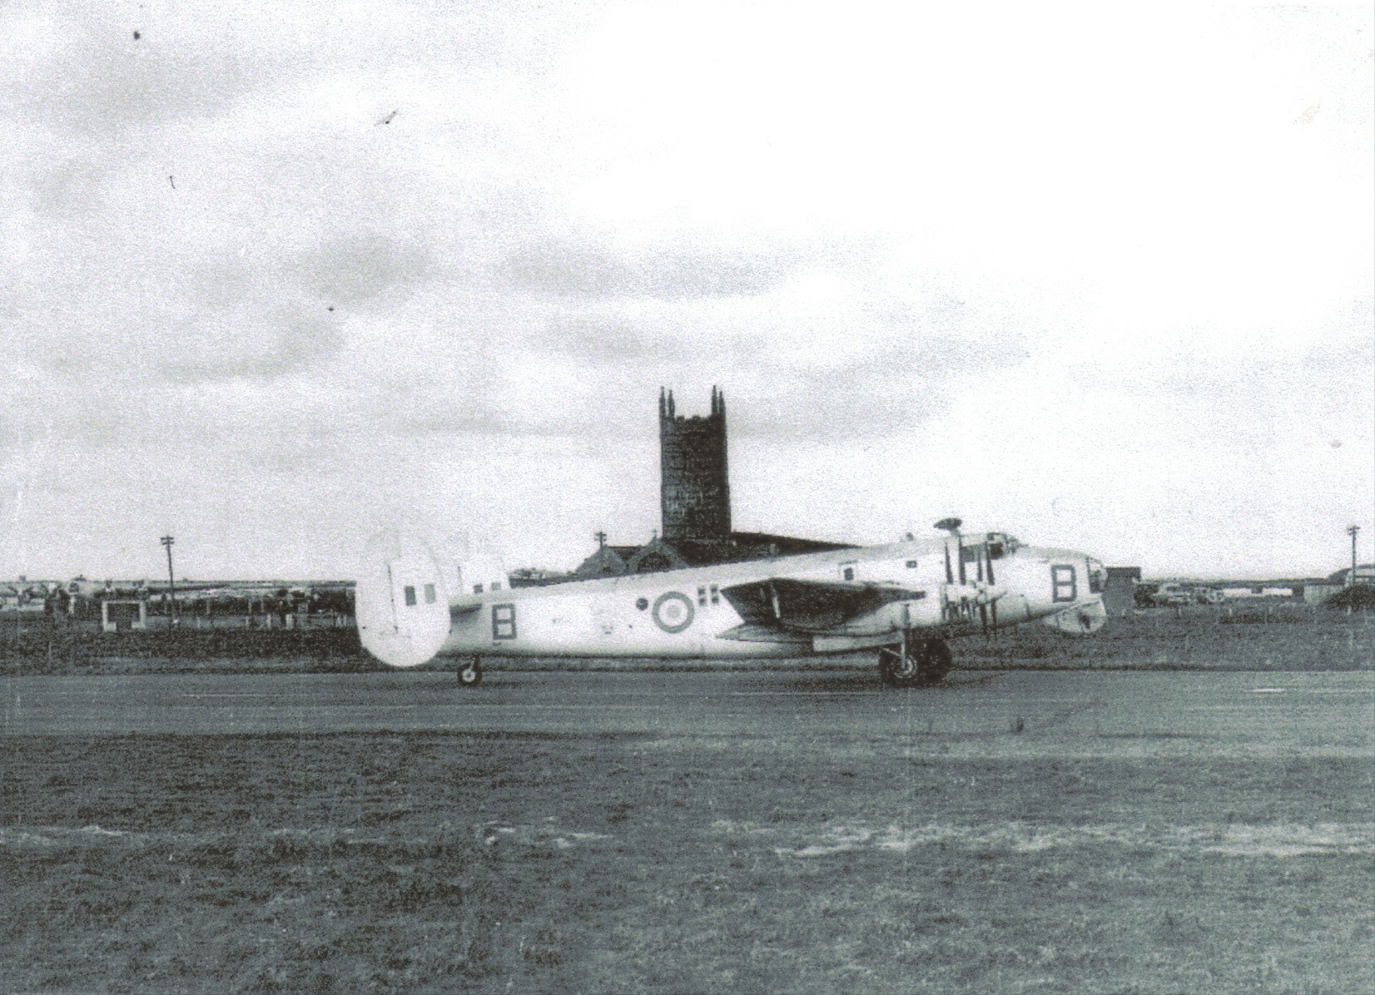
Shackleton 1950s

Slide 49
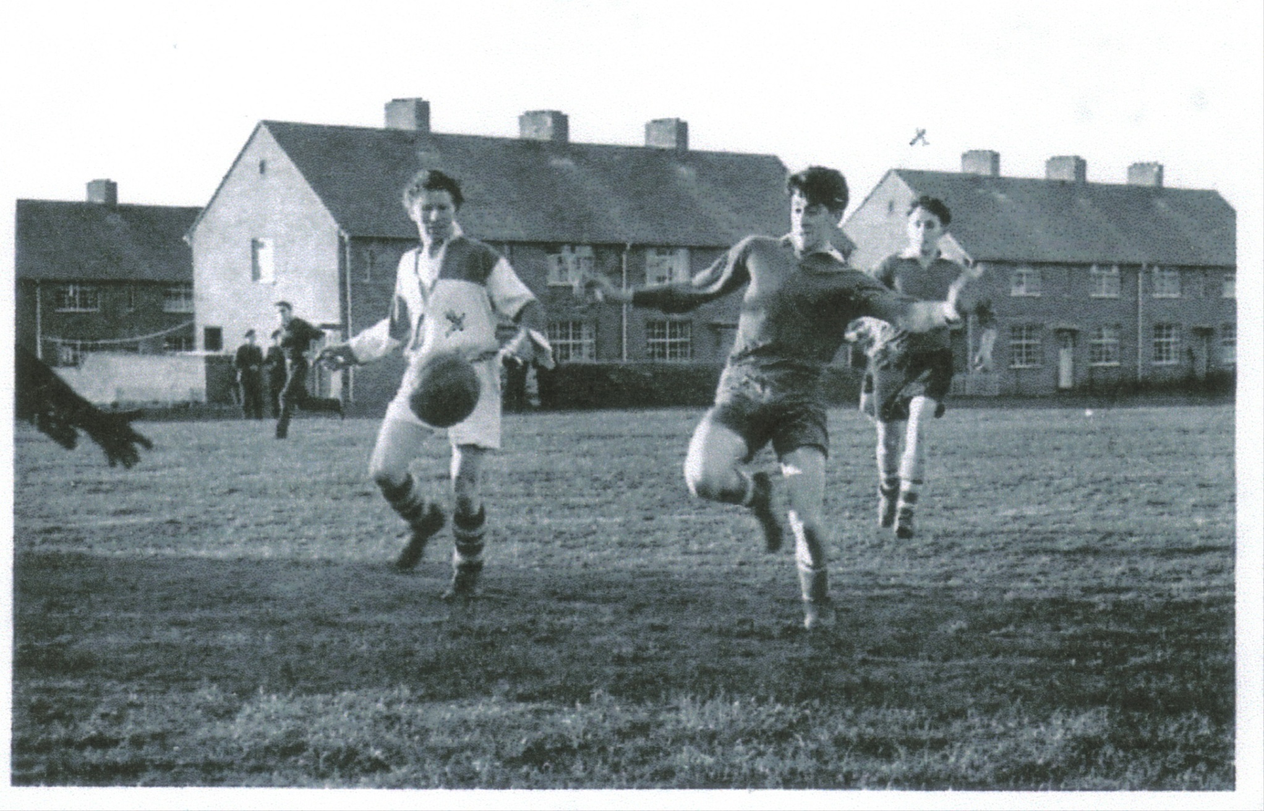

Slide 50


Slide 51


Slide 52


Slide 53


Slide 54


Slide 55


Slide 56


Slide 57


Slide 58


Slide 59


Slide 60


Slide 61


Slide 62


Slide 63


Slide 64

St Eval and St Ervan Home Guard

Slide 65


Slide 66


Slide 67


Slide 68


Slide 69


Slide 70


Slide 71


Slide 72


Slide 73


Slide 74


Slide 75

Betty Brewer’s family with RAF lodgers

Slide 76


Slide 77

Revd. Jolly and family evacuated to St Eval bungalow

Slide 78


Slide 79

Liberator Gr. Mk.VIII KK 332 Squad.224 1945

Slide 80

248 squad. Beaufighters St Eval 1941

Slide 81

FIDO 1944

Slide 82

Liberators GR.Mk.VI EW309 224 Squad.

Slide 83


Slide 84


